Slide 1
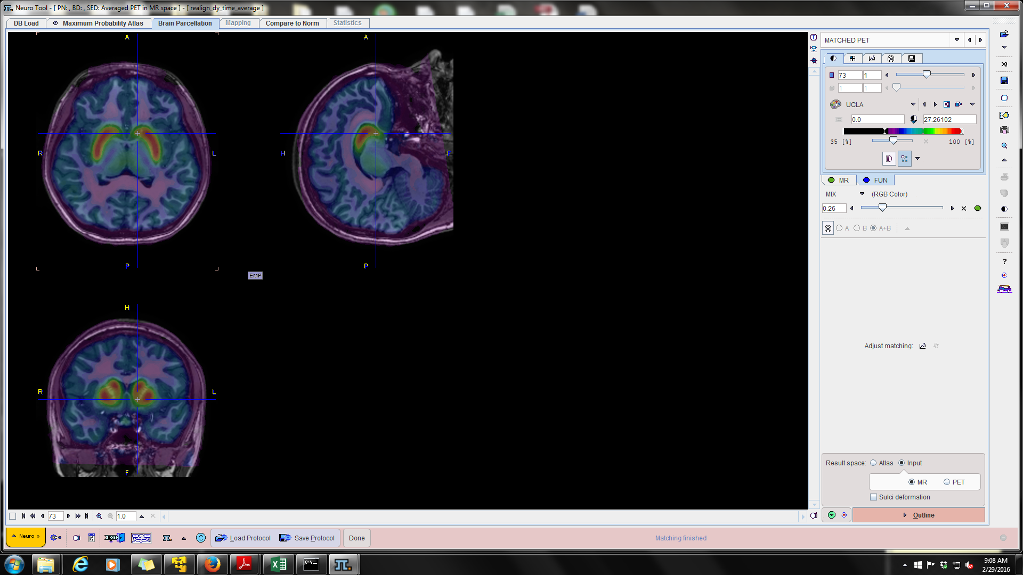
Dopamine, Decision Making, and Risk for Drug Addiction – Supplemental Slides
Chris Smith, PhD
Postdoctoral Fellow, Department of Psychology
Vanderbilt University
www.christophertsmith.com
October 10, 2017

Slide 2
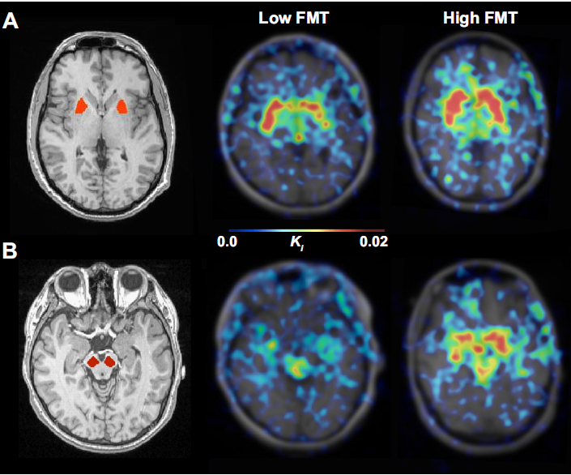
↓ midbrain DA synthesis,
↑ sensitivity to reward magnitude
HI FMT
Lo FMT
Smith et al., 2016 Journal of Neurophysiology

Slide 3
Estradiol and COMT Interact to Affect ICR in Naturally Cycling Women

Slide 4
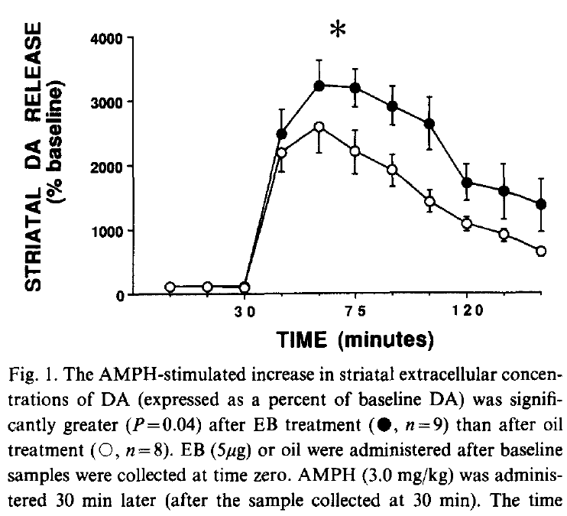
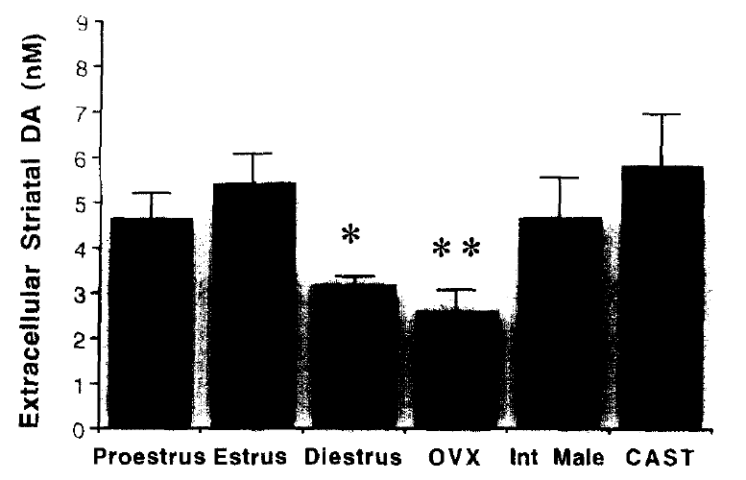
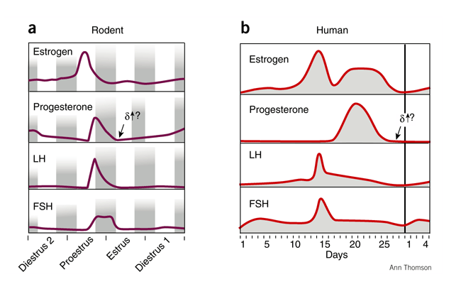
Estradiol (E) Modulates DA signaling
Becker et al., 1990: Estrogen enhances amph-induced DA release in striatum
Xiao and Becker, 1994: striatal DA levels ↓ when estrogen ↓
Rodent Estrus Cycle
Human Menstrual Cycle
Estrogen treatment
VEH
Staley & Scharfman, 2005
And naturally cycling E modulates DA-dependent frontal function:
Rodents (Shansky et al., 2004)
Humans, but data inconsistent (Rosenberg and Park, 2002; Gasbarri et al., 2008)
Notes:
17B estradiol is one of the most common estrogen steroid hormones in animals

Slide 5
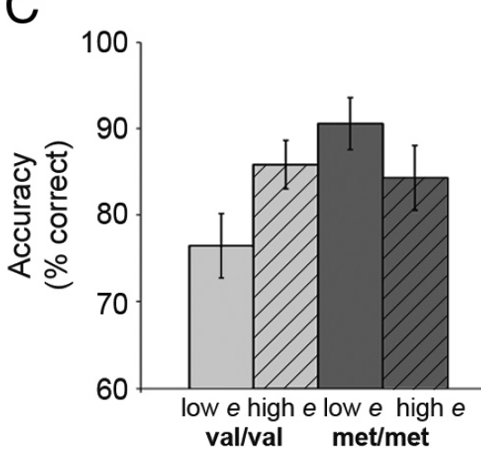
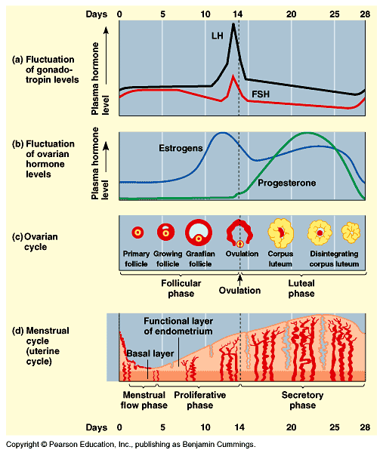
Ovarian Cycle Modulates Dopamine-dependent Frontal Function in a COMT-specific Manner
Hypotheses:
1) Does ICR change with E?
2) Do estradiol and COMT interact to affect ICR according to an inverted-U function?
Measured ICR:
Cycle Day 1-2 (MP, low E)
Cycle Day 11-12 (FP, high E)
Cognitive Performance
FP
MP
PFC DA
COMT Val/Val Met/Met
Jacobs & D’Esposito, 2011
Notes:
Used same verbal n-back task we employed in our study of DRD1 signaling
On the high-interference/high control
lure trials during the 2-back condition, val/val women
performed poorly at the start of their cycle when estradiol was low
and improved when estradiol levels were high. met/met women
showed the opposite pattern, with strong performance under low
estradiol conditions and impaired performance under high estradiol
conditions (Fig. 2C). Comparing the low DA (val, low estradiol)
and optimal DA (met, low estradiol) groups shows a
significant difference in 2-back lure accuracy.

Slide 6
As Estradiol ↑, ICR↓
*
↑estradiol
↑estradiol
†
ρ=-0.39, p=0.023
F (1,86) =4.54, p=0.036
MP FP
†t₂₂=-2.18, p=0.041
estradiol
Smith, Sierra, Oppler and Boettiger, J Neurosci, 2014.
Notes:
Sex differences need to be investigated further as other hormones or neuroactive steroids may be involved in regulating ICR.
Difference between E groups:
t₃₂=2.272, p=0.03

Slide 7
Predicted COMT x Cycle Effects on ICR
COMT genotype
Met/Met
Val carriers
↓ICR
↑ estradiol
PFC DA

Slide 8
Estradiol (E) Modulates ICR in a COMT-dependent Manner
↑E →↑ICR
↑E →↓ICR
ρ=0.12, p=0.75
ρ=-0.39, p=0.023
ρ=-0.58, p=0.003
Smith, Sierra, Oppler and Boettiger, J Neurosci, 2014.
Notes:
On the high-interference/high control
lure trials during the 2-back condition, val/val women
performed poorly at the start of their cycle when estradiol was low
and improved when estradiol levels were high. met/met women
showed the opposite pattern, with strong performance under low
estradiol conditions and impaired performance under high estradiol
conditions (Fig. 2C). Comparing the low DA (val, low estradiol)
and optimal DA (met, low estradiol) groups shows a
significant difference in 2-back lure accuracy.

Slide 10
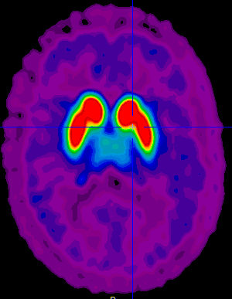
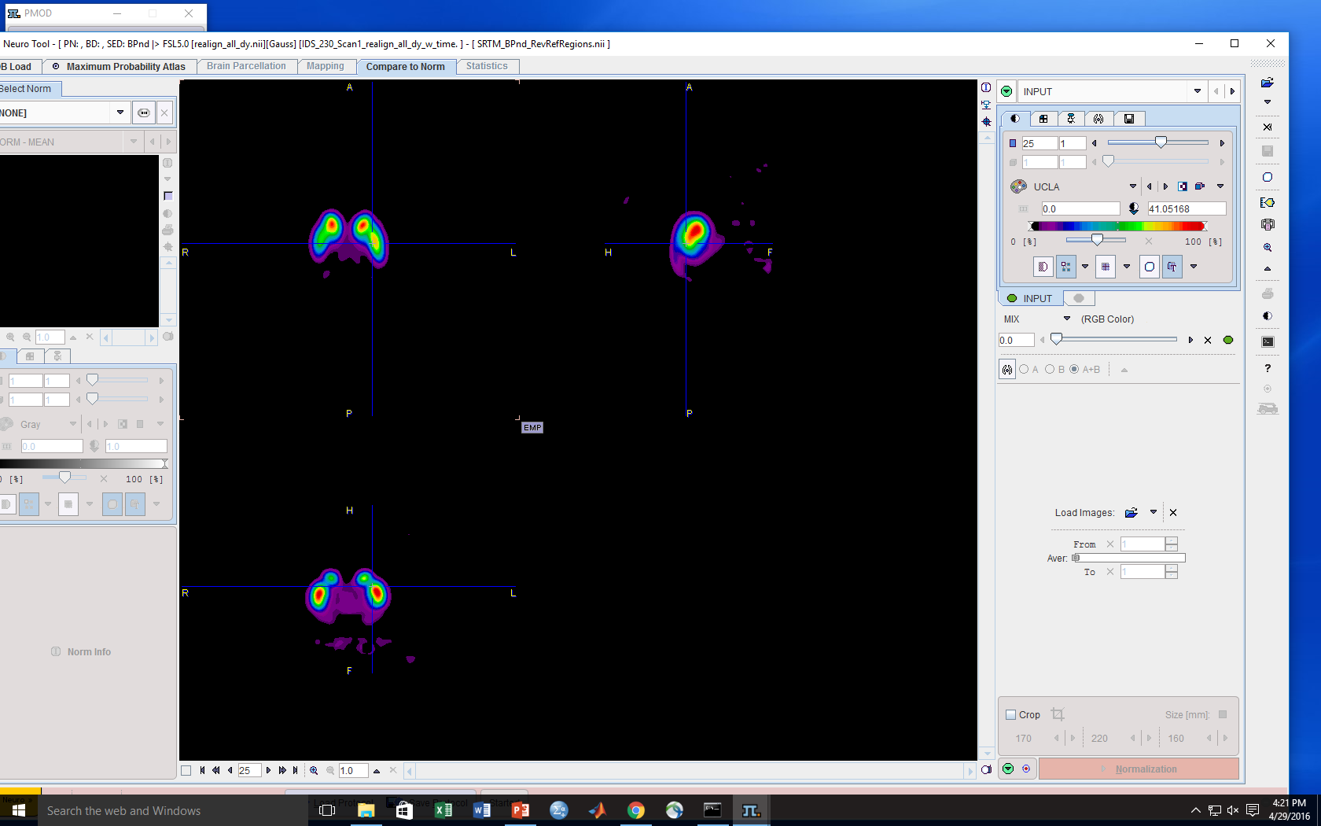
Courtesy: Mark Slifstein (Columbia)
¹⁸F-Fallypride has higher affinity for D2/3 receptors than the widely used tracer ¹¹C-raclopride
Raclopride can only quantify BPnd in the D2/3 receptor rich striatum
100%
thalamus
Fallypride Signal
50%
striatum
Thus, we can test for BPnd effects outside the striatum & have higher signal to noise in striatum
No prior genetic PET study has been able to do this due to the limitations of previously used radiotracers (raclopride, FLB-457)
0%

Slide 11
C957T effects on Fallypride BPnd

Slide 12
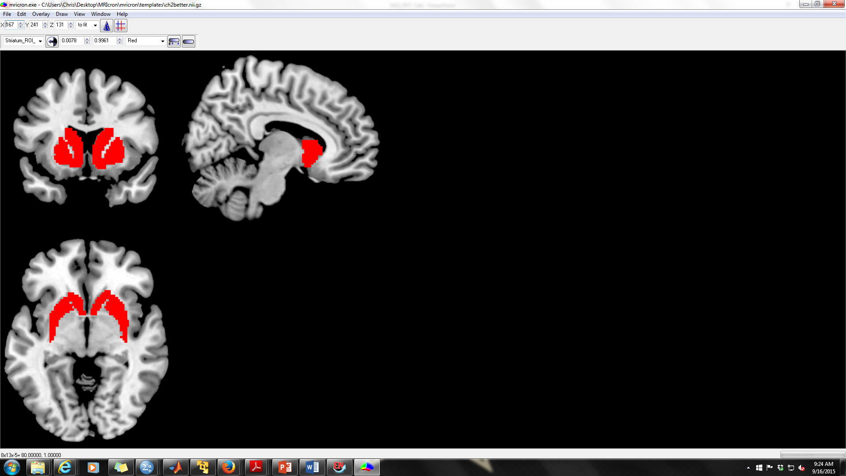
A Recent Meta-analysis of PET studies suggests the Taq1A single nucleotide polymorphism (SNP) affects striatal D2/3 receptor availability (BPnd)
All of these studies were limited in using methods that only allowed quantification of striatal D2/3 receptors
Another DRD2 SNP, -141C Ins/Del (rs1799732) has also been reported to impact striatal D2/3 BPnd, but the results have been inconsistent with Jonsson et al.(Jonsson et al., 1999) finding heightened BPnd in Del carriers and Pohjalainen et al.(Pohjalainen et al., 1999) finding no effect despite a similarly sized sample and use of the same radiotracer, ¹¹C-raclopride.
Gluskin & Mickey, 2016
Taq1A has also been used as a proxy for D2 receptor status, or more loosely as an index of general dopamine functioning (Klein et al., 2007; Jocham et al., 2009; Richter et al., 2013; Richter et al., 2014)

Slide 13
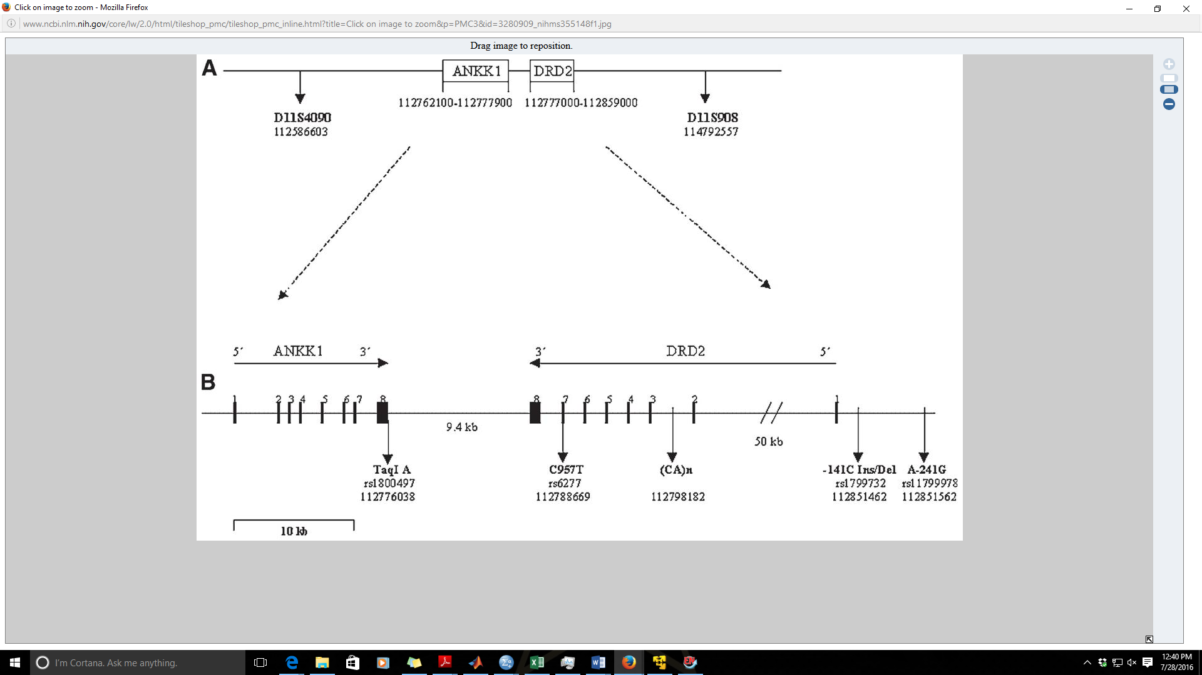
Hill et al., 2008
The Taq1A SNP, however, is not even in the DRD2 gene.
Other SNPs in DRD2 that are linked to Taq1A may be driving previously observed effects
However,
1) Only 2 PET studies focused on Ins/Del SNP; results did not converge
2) Only 2 PET studies (both from the same group) focused on C957T SNP (Gluskin & Mickey, 2016)
D’=0.83 (Duan et al., 2003)

Slide 14
Duan et al., 2003
The C957T SNP is a potential candidate as it affects DRD2 mRNA synthesis & stability in vitro (CHO-K1 cells)
DRD2 protein synthesis
Transcription inhibition with actinomycin D (ActD)
C957T 50% of wildtype (WT) at 60 min
C957T mRNA less stable over time

Slide 15
Hirvonen et al., 2004; 2005
Hypotheses & Statistical Analyses
SNPs in the DRD2 gene itself, particularly C957T, will predict D2/3 receptor availability (BPnd) better than Taq1A.
We tested for:
Linear effects of C957T T allele dose on BPnd (TT>CT>CC)
Hypothesis: T allele would be related to higher striatal BPnd
Linear effects of Taq1A A2 allele dose on BPnd (A2A2>A1A2>A1A1)
Group differences in Taq1A A2A2 versus A1 Carriers
Hypothesis: A2 allele would be related to higher striatal BPnd
Group differences in -141C Ins/Del Ins/Ins versus Del Carriers
Based on our individual SNP results, we tested for correlations between
Multilocus DRD2 SNP scores and BPnd as follows:
C957T T allele # + Ins/Ins (1) or Del Carrier (0) Score [range 0-4]
C597T T allele # + Taq1A A2 allele # [range: 0-6]
C957T T allele # + Ins/Ins (1) or Del Carrier + Taq1A A2 allele # [range: 0-7]
a priori significance criteria set at pFDR<0.05

Slide 16
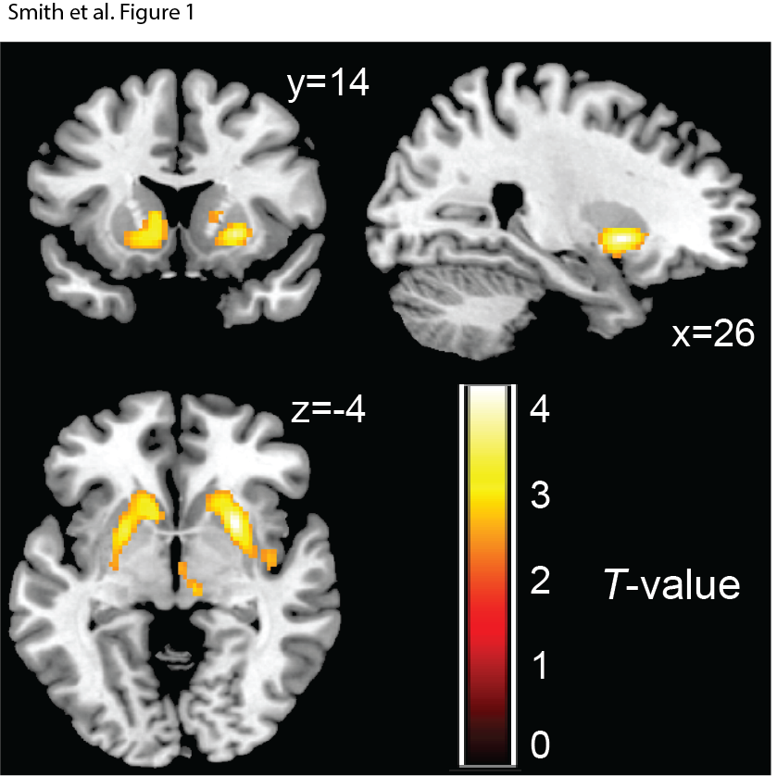
C957T T allele is associated with higher Fallypride BPnd in striatum (& midbrain/thalamus)
Replicate striatal effects observed previously (Hirvonen et al., 2004; 2005)
Cluster | MNI coord | # vox | T, pFDR
R striatum | 26, 10, -4 | 528 | 4.5, 0.018
L striatum | -24, 4, -2 | 516 | 3.9, 0.018
Striatal BPnd
No clusters in either the Taq1A or Ins/Del single SNP analyses survived the pFDR<0.05 criterion.
CC
CT
TT
Smith et al., 2017 Translational Psychiatry

Slide 17
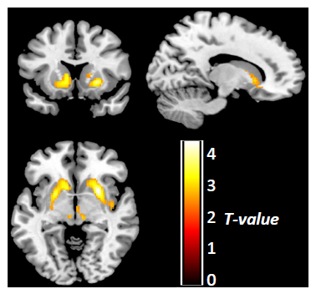
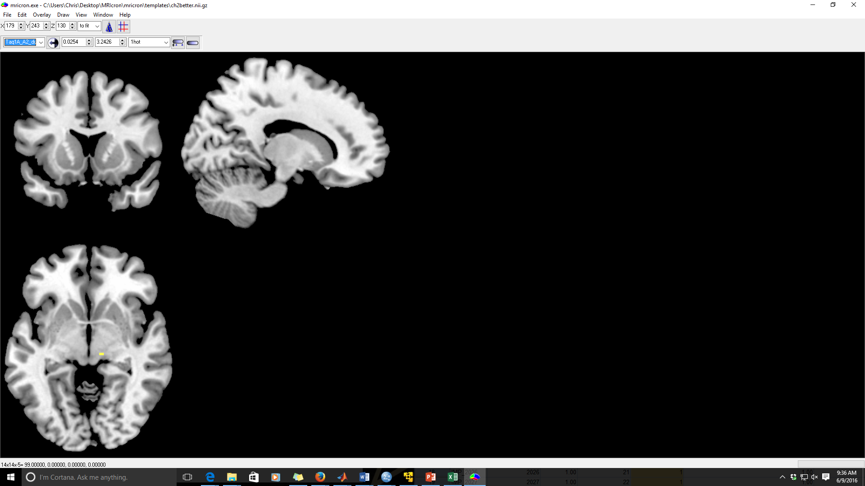
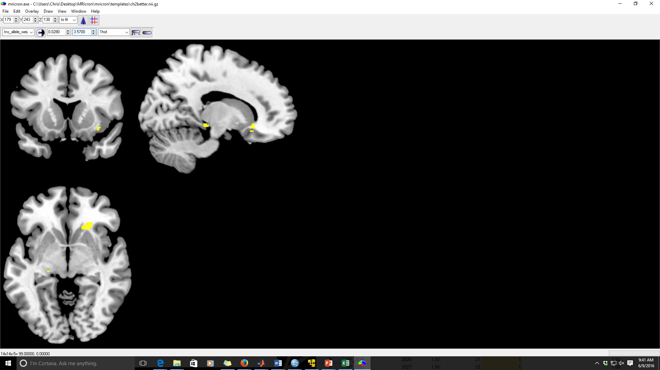
No effect of Taq1A or Ins/Del SNPs on striatal BPnd
Effects of each SNP on BPnd (p<0.005, uncorrected)
C957T
Taq1A
Ins/Del
y=14
z=-5

Slide 18
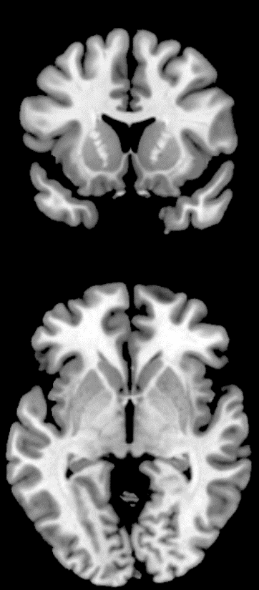
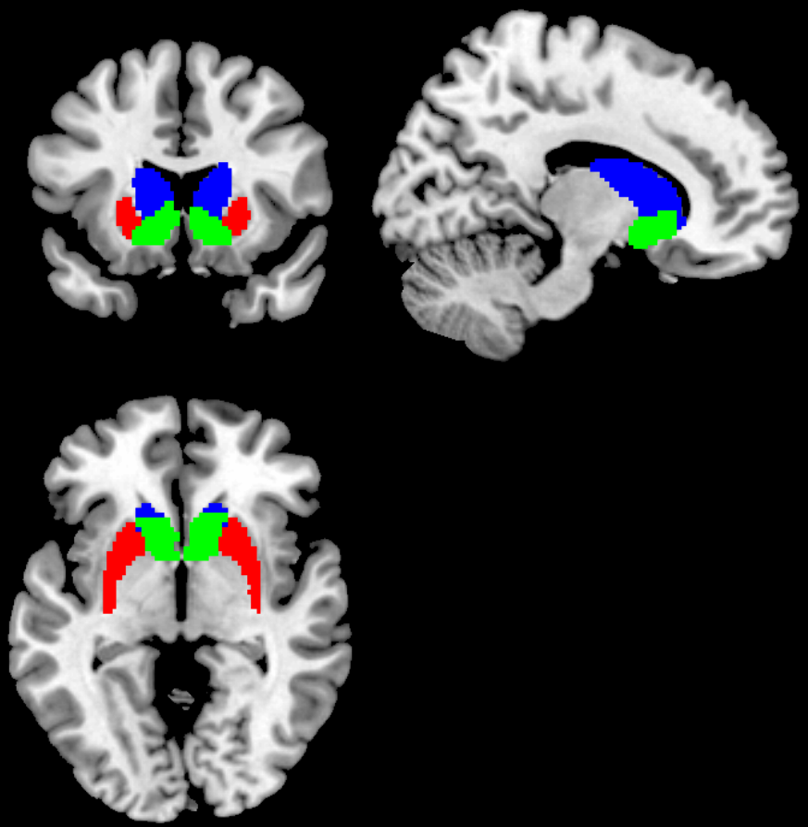
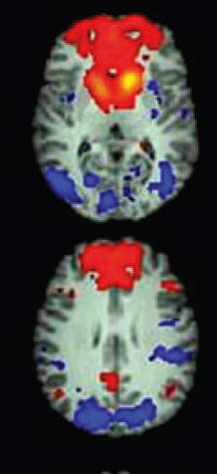
Striatal subdivisions are differentially connected in the brain, responsible for different processes
Striatal Functional Connectivity (Di Martino et al., 2008)
Putamen
Caudate
Ventral Striatum
Caudate
Putamen
Ventral
Striatum
Mawlawi et al., 2001 Striatal ROIs
MNI coord: 12, 15, -3

Slide 19
C957T SNP is associated with BPnd in Ventral Striatum (VS) & Putamen
Voxelwise result
**
**
#
#
**
**
#
*
*
**p<0.01, *p<0.05, #p<0.10 reflect significant across genotype group differences in BPnd, controlling for age and sex
Smith et al., 2017 Translational Psychiatry

Slide 20
C957T (but not other SNPs) predicts BPnd in anatomically derived putamen and VS ROIs
Results of step-wise multiple regression analyses
(age & sex entered as 1st level predictors)
y=14
Ventral Striatum | Beta | R² | F-change, p
C957T | 0.325 | 0.185 | 10.24, 0.002
+InsDel | 0.053 | 0.177 | 0.238, ns
+Taq1A | -0.013 | 0.166 | 0.014, ns
Putamen | Beta | R² | F-change, p
C957T | 0.304 | 0.065 | 7.80, 0.007
+InsDel | -0.004 | 0.054 | 0.001, ns
+Taq1A | 0.048 | 0.043 | 0.171, ns
Caudate | Beta | R² | F-change, p
C957T | 0.122 | 0.005 | 1.16, ns
+InsDel | -0.102 | 0.008 | 0.721, ns
+Taq1A | -0.061 | 0.018 | 0.252, ns
Smith et al., 2017 Translational Psychiatry

Slide 22
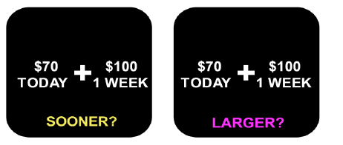

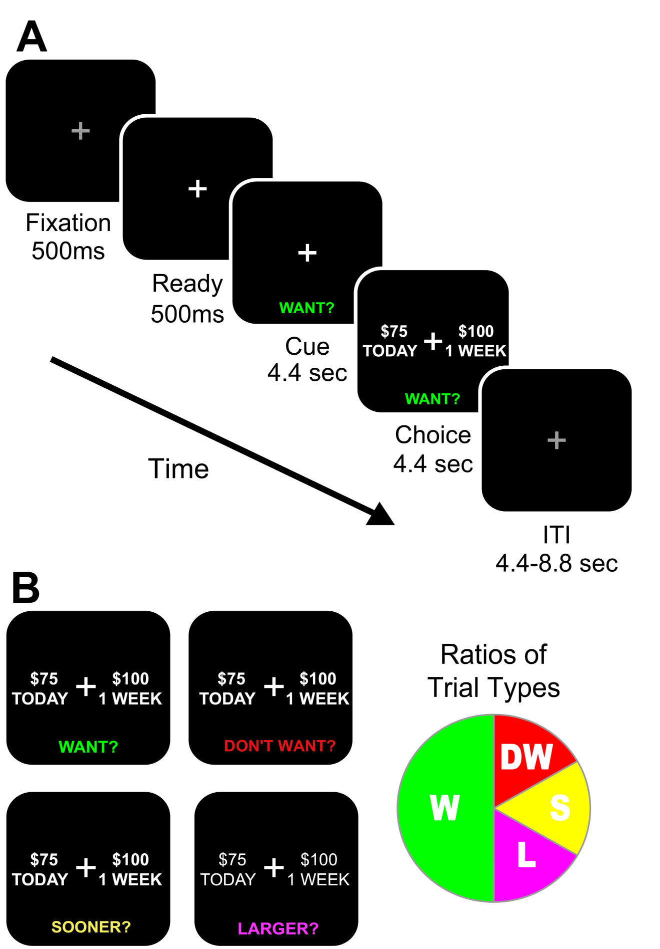
Advantages to Assessing Now Bias With Our Task
CONTROL (CON) Trials
Subjective Trials (RTs should be larger)
DW
S
W
L
Notes:
Trial types intermixed to lessen the affect of previous WANT? choices biasing current choice

Slide 23
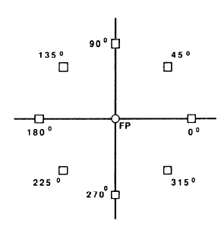
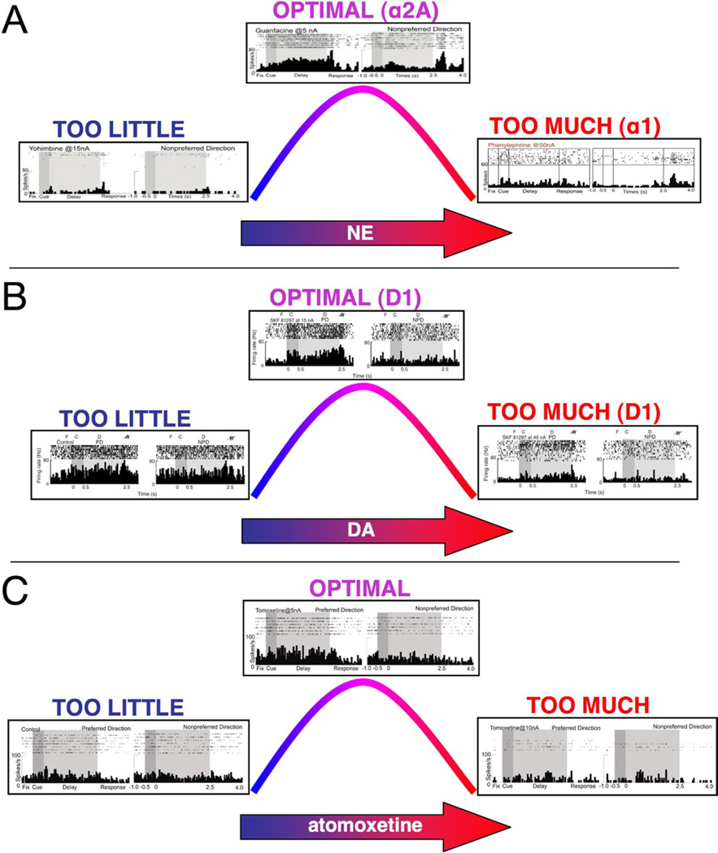
DA Tunes PFC to ↑ Performance, ↓ Errors
Response
Delay
Cue
X
3-6 sec
Optimum DA
Funahashi, Bruce, Goldman-Rakic, 1989
Too Little DA
Too Much DA
PFC DA
Target
Non-Target
Target
Non-Target
Target
Non-Target
Arnsten, 2011
Relationship also observed in human studies:
Wisconsin Card Sorting Task: Egan et al., 2001; Malhotra et al., 2002
n-back Working Memory Task: Jacobs & D’Esposito, 2011
Smith CT, Swift-Scanlan T, Boettiger CA; 2014
Notes:
The work of Goldman-Rakic (23) revealed the microcircuitry in PFC that underlies spatially
tuned, persistent firing during a spatial working memory task. Her work showed that layer
III pyramidal cells excite each other through connections on spines to maintain persistent
firing over the delay period (Figure 2D).
D1 receptor stimulation sculpts
neuronal firing by decreasing firing to nonpreferred inputs (i.e., decreasing noise [109]). In
contrast to moderate D1/5 receptor stimulation, high doses of D1/5 agonist suppress all
neuronal firing (Figure 3B, right side of curve). These actions likely contribute to impaired
working memory abilities during uncontrollable stress exposure, when high levels of DA are
released in PFC. The potential mechanisms underlying this inverted U are briefly discussed
below. For a more lengthy discussion, please see Arnsten et al. (100).
D1/5
receptor stimulation appears to increase the evoked excitability of pyramidal cells while
reducing spontaneous excitability by acting in concert on the persistent sodium current,
high-threshold dendritic calcium spikes, and a slowly inactivating potassium current (112).
The D1/5 agonists increased NMDA receptor-mediated synaptic currents while slightly
reducing α-amino-3-hydroxy-5-methyl-4-isoxazolepropionic acid receptor currents, leading
to enhancement of sustained excitatory postsynaptic potential trains (113). The D1/5
receptor agonists also appear to shift the activation curve of the persistent sodium current to
more hyperpolarized potentials, thus contributing further to signal-to-noise improvements
(114,115). Intracellular recordings from layer II/III PFC pyramidal neurons have shown that
D1/5 receptor stimulation may promote excitation by increasing the amplitude of excitatory
postsynaptic currents through calcium, protein kinase A, and calcium/calmodulin-dependent
protein kinase II mechanisms (116). Thus, a variety of mechanisms may contribute to D1/5
excitatory actions.

Slide 24
If an inverted-U model explains PFC DA (COMT x age) effects on ICR…..
COMT genotype
Met/Met
18-21 yr olds
Val carriers
22-40 yr olds
↓ICR
Met/Met
22-40 yr olds
↑ estradiol
Val carriers
18-21 yr olds
PFC DA
Adapted from Smith and Boettiger 2012, Psychopharmacology

Slide 26
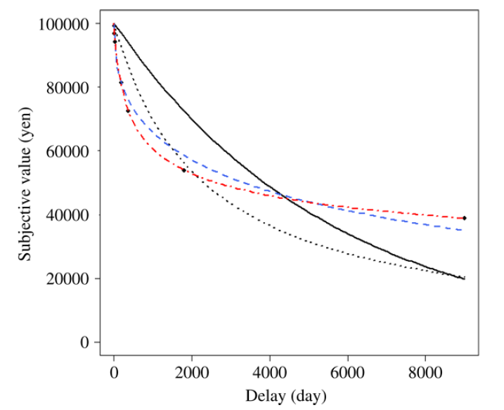
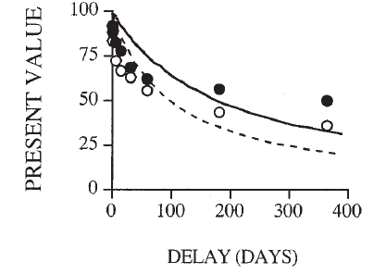
ICR is a model-free measure of discounting behavior that correlates with more traditional measures (k)
Modified from Takahashi et al., 2008
Traditionally, curves of subjective value of the delayed reward versus time are plotted and a discount slope term, k, is computed.
Using the more sophisticated q-exp method to calculate k in a sample of 174 administrations of our Delay Discounting Task (Mitchell et al., 2005)
V(q)=A/[1+(1-q)k_{q}D]^{1/(1-q)}
Only 134 datasets could be fit to the model (~77%).
In those that did, however, ICR was highly correlated with k
exp
Subject value of Delayed Reward
hyper
Delay (days)
Studies have suggested discounting is:
Exponential (Meyer, 1976): V = Ae^{-kD}
OR
Hyperbolic (Mazur, 1987): V=A/(1+kD)
Q-exponential discount function:
Taking into account logarithmic time perception (Takahashi et al., 2007; 2008):
V(q)=A/[1+(1-q)k_{q}D]^{1/(1-q)}
Notes:
One,
the normative economic approach (e.g., Lancaster, 1963;
Meyer, 1976; Samuelson, 1937), attempts to understand
discounting as rational decision-making and uses economic
theory and assumptions in its mathematical account of discounting:
V =Ae-kD
In this exponential discounting equation, A is the amount of
the reward delivered after delay D, and the free parameter k
is an empirically derived measure of the degree to which the
individual discounts the value (V) of the delayed reward.
According to this equation, the subjective value of a reward
decreases exponentially with increasing delays.
The second
approach, taken by psychologists beginning in the 1960s
(e.g., Chung, 1965; Logan, 1965), mathematically describes
observed choices between immediate and delayed outcomes.
This approach suggests that the form of the delay
discounting function is hyperbolic (deVilliers & Herrnstein,
1976). Mazur (1987), using a psychophysical technique to
quantify delay discounting in animal subjects, proposed the following hyperbolic discounting equation:
V A/(1 kD)
in which the parameters are identical to Equation 1.
In regards to the q-exponential function:
Weber-Fechner time perception is included in the model.
Parameter q indicates the deviation from exponential discounting; when
q＝0, the q-exponential discounting is equivalent to the simple
hyperbolic function and when q→1
,the q-exponential discounting is equivalent to the exponential function.
The q-exponential function can parametrize the deviation of temporal discounting from an exponential function as 1−q.
A recent study demonstrated that the q-exponential discount model better explained human
intertemporal choice behavior than the exponential and
simple hyperbolic discount models (Takahashi et al.
(2008)) even considering the model complexity (graph at upper right of slide)
Q and kq indicate time consistency of responses
A=objective amount of reward
D=objective/physical delay length
V=subjective value

Slide 28
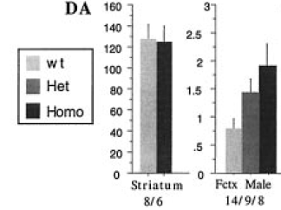
Catechol-O-methyltransferase (COMT) & Val158Met Polymorphism
COMT main regulator of PFC DA (accounts for ~60% of DA turnover in this part of brain; Gogos et al., 1998)
In Humans, MetMet COMT polymorphism associated with less DA turnover, higher extracellular DA levels in PFC while ValVal individuals are thought to have lower PFC DA levels
COMT KO mice
Saw no significant differences in NE or 5-HT levels in frontal cortex of COMT KO mice.

Slide 29
More on our Delay Discounting Task

Slide 30



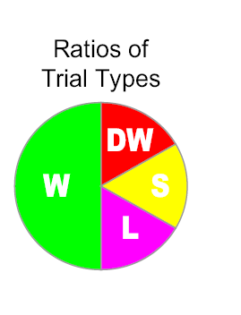
Reaction Times and Accuracy on Control Trials Used to Screen Out Those Not Performing the Task as Instructed
Objective Trials (Check Accuracy)
Subjective Trials (RTs should be larger)
Boettiger et al., 2007
Notes:
Update for clarity

Slide 31
How ICR Changes with Increasing Delayed Reward

Slide 32
How ICRChanges with Increasing Wait Time

Slide 33
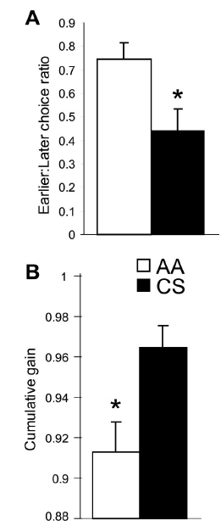
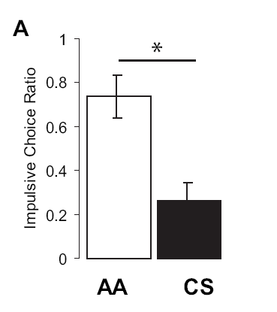
Previous ICR findings
Mitchell et al., 2005
Boettiger et al., 2007

Slide 34
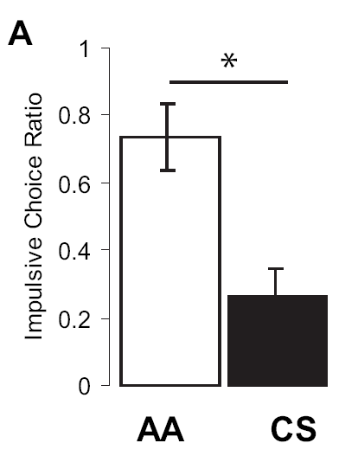
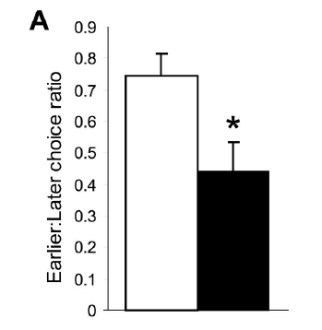
Previous Results: Delay Discounting
Mean age = 29 ± 6
Mean Age = 28.3 ± 5.8
Mean age = 26 ± 6
Boettiger et al., 2007
Mitchell et al.,2005
Notes:
Frontal lobe dopamine concentration is inversely related to impulsive choice bias: the role of COMT 158 polymorphism.
Acute elevation of frontal dopamine reduces impulsive choices.
VAL158met polymorphisim of the COMT gene modulates frontal lobe dopamine levels.
Mean age is 28. Which doesn’t seem like it’s that different from the age I’m targeting. But there is evidence that frontal cortex development continues at least into the early or late twenties. This group may be slightly older than the one I’m interested in targeting. Additionally, the val/val genotype predicted activity in dorsal prefrontal cortex and posterior parietal cortex. Activity in both areas is associated with immediate reward bias.

