Slide 1
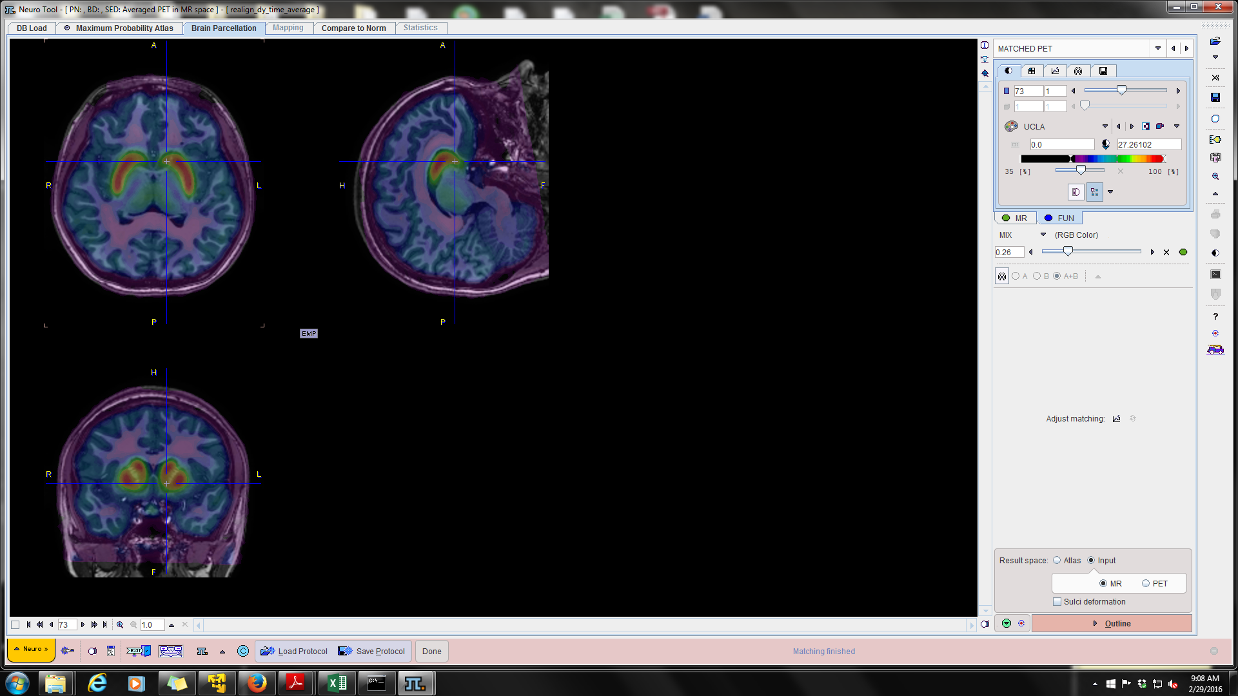
Dopamine, Decision Making, and Risk for Drug Addiction
Chris Smith, PhD
Postdoctoral Fellow, Department of Psychology
Vanderbilt University
www.christophertsmith.com
October 10, 2017

Slide 2
Outline
Dopamine and drugs of abuse
Intermediate phenotypes & study of drug/alcohol abuse
Immediate Reward Selection Bias
    Definition & Measurement = Impulsive Choice Ratio (ICR)
  ICR as intermediate phenotype for alcohol use disorder
  ICR modulation by dopamine, implications for personalized dopaminergic treatments
  Using Positron Emission Tomography (PET) to evaluate the role of dopamine in ICR and risk for drug abuse

Slide 3
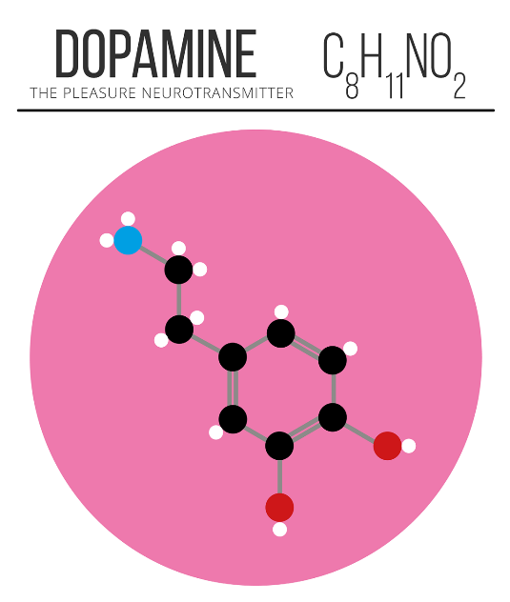
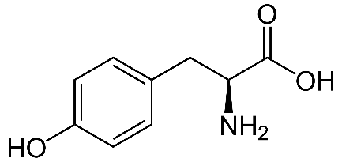
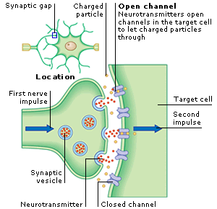

Dopamine (DA)
Precursor:
Amino acid tyrosine
Dopamine is a monoamine neurotransmitter that modulates neural signaling in the brain
All drugs of abuse lead to the release of DA in the brain
Lower DA D2 receptor availability (measured with PET) is associated with drug addiction in humans (Volkow et al., 2004) and addiction risk in monkeys (Nader et al., 2006) & rodents (Dalley et al., 2007)
Drug Abuser
Control
Cocaine
Meth
Heroin
Alcohol

Slide 4
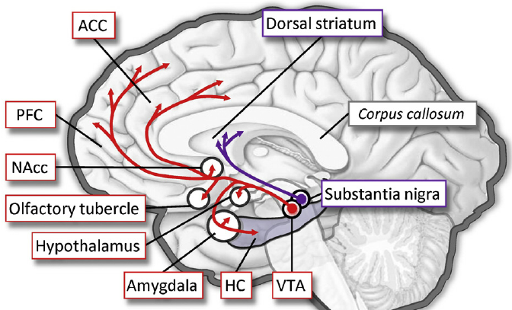
The Dopamine System
Mesocorticolimbic pathway
Nigrostriatal pathway
ACC: Anterior Cingulate Cortex
PFC: Prefrontal Cortex
VS: Ventral Striatum
VS
HC: Hippocampus
VTA: ventral tegmental area
Striatum: reward, learning, salience
Movement Initiation
Parkinson’s Disease leads to loss of DA
signaling in nigrostriatal pathway
PFC: maintaining goals, working memory

Slide 5
Alcohol Use Disorders (AUDs):
Costly, Complex, Poorly Understood
Costs of excessive Alcohol consumption:
  $235 billion (Rehm et al., 2009), 80,000 deaths annually (CDC)
  18% of Americans will experience AUDs during lifetime (Hasin et al., 2007)
AUDs: Highly heritable (30-60%)
AUDs
Intermediate Phenotype
Genetic/biological Risk
Immediate Reward Selection Bias
Notes:
Due to its strong association with addiction, availability of well established animal models,
and relatively well elucidated neural substrates, DD can potentially serve as an intermediate
biobehavioral phenotype that could help bridge the gap between genetic risk factors and
complex psychiatric phenotypes such as substance use or externalizing disorders in which
impulsivity is implicated as a core underlying dysfunction. An important requirement of
such an intermediate phenotype is its heritability. However, little is currently known about
the relative contribution of genetic and environmental factors to individual differences in
DD in humans.
approximately 10% of Americans will suffer from alcoholism¹
30% of alcoholics receive treatment²
only 10% use medication³
1: Grant (1994) Addiction 89:1357-1365
2: Cohen et al. (2007) Drug Alcohol Depend 86:214-221.
3: Mark TL et al. (2003) Drug Alcohol Depend 71:219-228.
Boothby and Doering (2005) Clin Ther 27:695-714.

Slide 6
Immediate Reward Selection Bias
A
B
Best short-term choice
Best long-term
choice
“Now”
>
“Later”

Slide 7

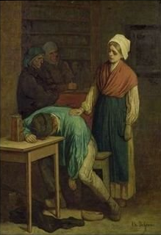


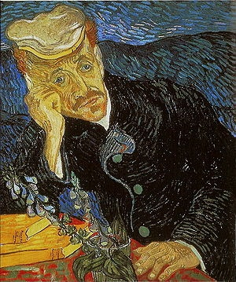
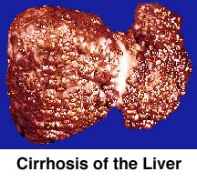
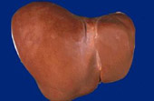
Relationship to addiction?
Notes:
Alcohol Use Disorders (AUDs) are complex and heterogenous and can be the result of many precipitating events
Makes study of the neural basis of AUDs difficult
Understanding behavioral markers of possible alcohol use disorders could help in targeting treatment to those in need
To better understand the neurobiology of alcohol use disorders, we study an intermediate behavioral phenotype common to these disorders:
Immediate reward bias (choosing Now over Later)

Slide 8

Quantifying Immediate Reward Selection Bias
Delay Discounting Task
ICR Range:
    more impulsive
    less impulsive
Impulsive Choice Ratio (ICR):
NOW
LATER
now choices
total choices
1
ICR can be conceptualized as a measure of Now choice bias
0
Mitchell et al. (2005); Boettiger et al. (2007).
Notes:
Point out NOW and Later
Immediate Reward Bias is one intermediate phenotype of substance use disorders
Based on the relationship between IRB and addiction vulnerability, we are trying to elucidate the neural mechanisms behind this phenotype.
- IRB is commonly observed in gamblers and people with substance use disorders
- Abstinent alcoholics display a larger IRB than control subjects (Mitchell et al., 2005)
- IRB is a risk factor for alcohol dependence (Poikolainen, 2000)
Impulsivity is a broad term that is difficult to define.
So, quantifying impulsivity in some definable way is useful to begin studying this behavior.

Slide 9
Criteria for Categorizing a Measure as an Intermediate Phenotype
Criteria: Met by ICR?
Good psychometric properties: measure consistent & stable over time
Measure related to the disorder it is associated with (explains symptoms)
Sufficiently Heritable (genetic basis)
  Mitchell, 2011; Anokhin et al., 2011
Show increased expression in unaffected relatives of those with the disorder
YES
YES
Role of COMT?
Boettiger et al., 2007
Not shown sufficiently yet
Meyer-Lindenberg & Weinberger, 2006; MacKillop, 2013
Notes:
DD is thought to be ~40% heritable in animals (Wilhelm and Mitchell, 2009) and ~50% in humans – 12-14 yr old adolescent twin pairs presented with one “real” Now vs Later choice ($7 today or $10 in a week?) (Anokhin et al., 2011)
The preference for immediate but smaller rewards may be a behavioral marker of underlying
genetic liability to impaired decision making and could serve as a useful endophenotype for
genetic studies of the etiology of substance use disorders. The finding of genetic influences
on this behavioral phenotype raises the question about genetic influences on specific neural
substrates underlying intertemporal choices. These issues need to be addressed in future
studies using cognitive brain electrophysiology and/or functional neuroimaging methods in
genetically informative designs.

Slide 10
See: Mitchell et al., 2005; Smith et al., 2015 Frontiers in Human Neuroscience

Slide 11
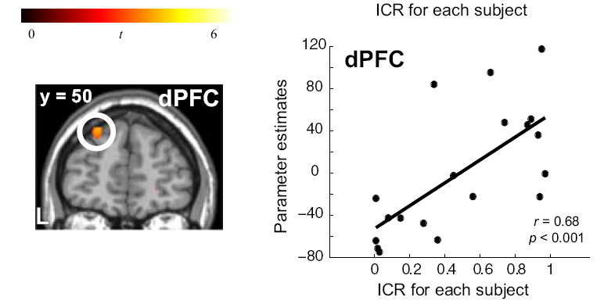
What neurobiological processes underlie ICR?
  Prefrontal cortex (PFC) function is involved
  Important in Cognitive Control and Maintaining a Goal Representation
  Modulated by dopamine (DA); often via an inverted-U function (intermediate DA levels = optimal performance)
Boettiger et al., J Neurosci 2007
Notes:
Dopamine (DA) critically modulates PFC function
What is the relationship between PFC DA and ICR?

Slide 12


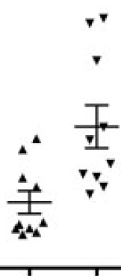
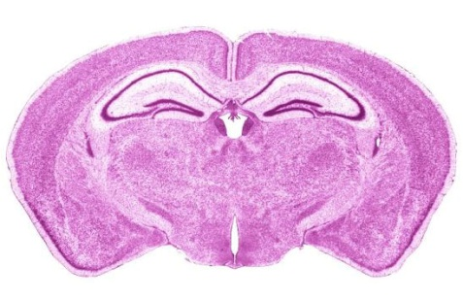
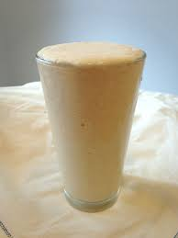

Assessing Role of PFC DA in Task Performance
In animals
In humans
Pharmacology:
D2R agonists, antagonists
↑ DA: amphetamine
Global DA depletion
- Kelm and Boettiger, 2013 JOCN
Genetic variants
D1 or D2 receptor
agonists, antagonists
[DA]
dPFC
striatum
DA levels
catechol-O-methyltransferase (COMT) gene
SNP: G → A @ codon 158
VV MM
VV MM
Val → Met
¹⁸F-DOPA PET Study (Wu et al., 2012)
↑COMT act
↓DA
↓COMT act
↑DA
Notes:
COMT as presynaptic measure of frontal DA (extracellular/presynaptic DA availability)
Both human and animal studies have suggested a somewhat
complex COMT-by-sex interaction effect (Gogos et al.,1998;Harrison and Tunbridge, 2008).
Catechol-O-methyltransferase (COMT) is a ubiquitous enzyme which inactivates cathecolami-
nergic neurotransmitters, i.e. dopamine (DA), adrenaline,
noradrenaline (NE) as well as catechol estrogens and exogenous
catechols. A common single nucleotide polymorphism (SNP)
G/A (rs4680), located in exon 4 of the COMT gene, leads to a
change at the first position of codon 158 of the membrane-
bound COMT isoform, which is the predominant isoform in the
central nervous system. The SNP results in an amino acid
substitution with differential enzymatic activity, from Valine
(Val) to Methionine (Met) with high activity and low activity,
respectively.
In vitro experiments suggest a three- to four-fold
difference in enzyme activity between Val and Met homozy-
gotes, while heterozygotes have intermediate enzyme activity (Chen et al., 2004)

Slide 13
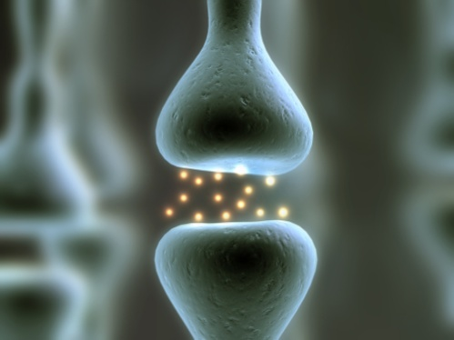
PFC DA Level is Controlled by the Enzyme Catechol-O-methyltransferase (COMT)
Val/Val COMT
Met/Met COMT
Tyrosine
TH
L-DOPA
AADC
Dopamine
DAT
Dopamine
DAT
COMT
COMT
DA
TH: tyrosine hydroxylase
AADC: aromatic amino acid decarboxylase
DAT: dopamine transporter
3-MT: 3-methoxytyramine
3-MT
PFC DA
Notes:
Make point that there are very little to no DA transporters in the PFC
DA neurons projecting to the PFC have higher baseline firing and higher rate of dopamine turnover than other DA neurons
projecting to the striatum (Thierry et al., 1976;Tam et al., 1990)
The PFC contains significantly less dopamine transporter protein than other brain regions (Sanchez-Gonzalez & Cavada, 2003 (monkey) and Sesack et al, 1998 (rat))
This results in the enzyme catechol-O-methyltransferase (COMT) being the primary means of DA clearance in the PFC (accounts for 60% of clearance in PFC) (Karoum et al., 1994)
A single base-pair substitution of G for A at residue 158 of the COMT gene results in the substitution of Met for Val at this residue
The Met polymorphism lowers the efficacy of the COMT enzyme such that it degrades DA at only 25% the rate of the Val variant (Lotta et al., 1995; Lachman et al., 1996)
COMT functional polymorphism
Ancestral – Val
Novel form (new to humans) – Met
MetMet Degrades DA at 1/4th rate of Val/Val polymorphism
So, for MetMet, DA persists in extracellular space longer (DA’s action prolonged)
↑ PFC DA in MetMet → ↑ performance on frontal-dependent cognitive tasks
(Egan et al., 2001; Goldberg et al., 2003; Mattay et al., 2003; Diamond et al., 2004; Nolan et al., 2004)
The Met/Met COMT polymorphism (resulting in high levels of extracellular PFC dopamine) is associated with better performance on many frontal-dependent cognitive tasks (Iowa gambling task, working memory tasks, attentional control tasks, Wisconsin Card Sorting Task (Egan et al., 2001; preservative errors) etc…)
In Egan paper, Val/Val individuals had significantly higher activity in dorsolateral PFC (dPFC) and more preservative errors than other COMT genotypes

Slide 14
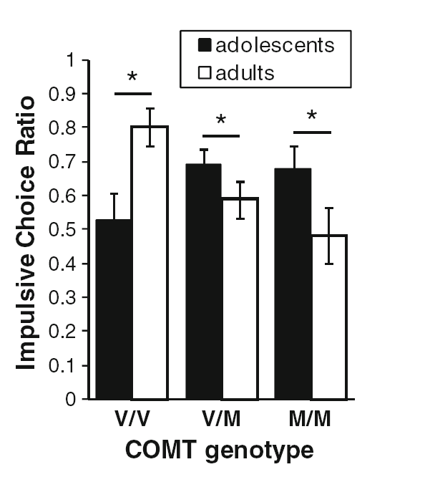
Age and COMT interact to affect ICR
↓DA w/ age
M/M
DA
optimum
V/V
Age
PFC DA
η²=0.069
Smith and Boettiger, Psychopharmacology 2012
Notes:
What can explain the different effect of the COMT polymorphism on ICR between adults (ages 22-40) and adolescents (18-21)?

Slide 15
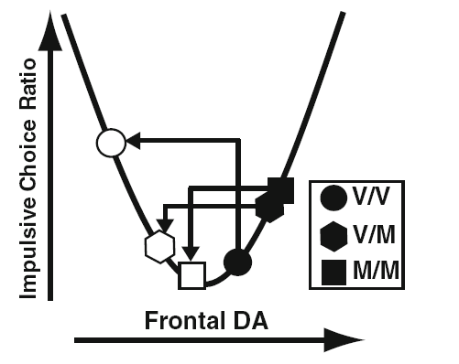
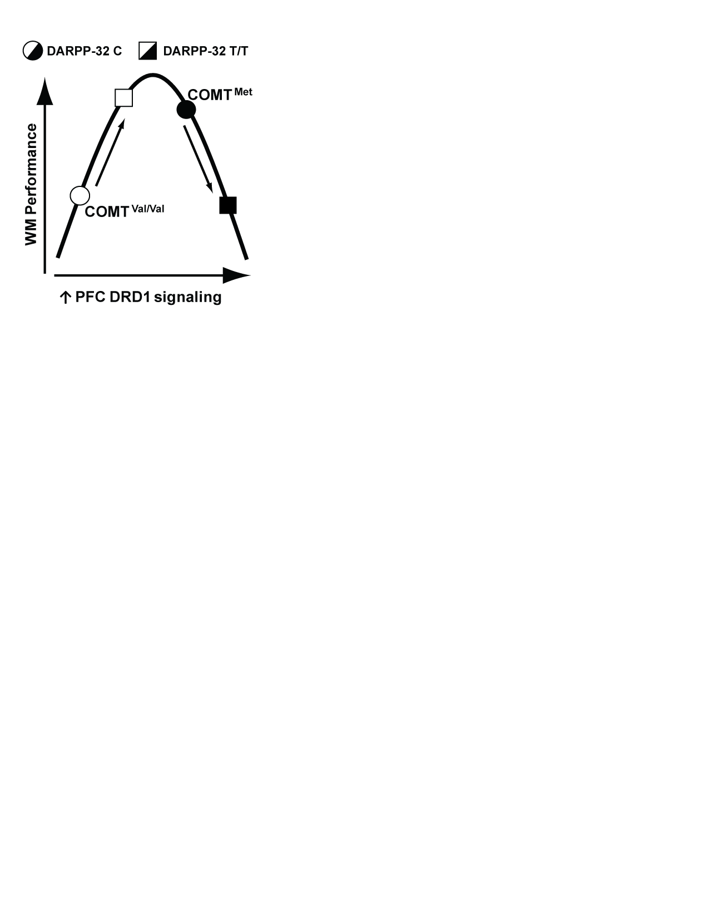


Relationship between ICR, COMT, and Age Follows an Inverted-U Function
COMT genotype
V/V
V/M
M/M
↓ICR
Adults (22-40)
Late Adolescents (18-21)
Frontal DA
Smith and Boettiger, Psychopharmacology 2012
Notes:
DA signaling declines with age (Wahlstrom et al., 2010)
COMT expression increases with age (Tunbridge et al., 2007)
Result: lower frontal DA with age
Several measures of frontal DA neurotransmission decrease from adolescence to adulthood (see (Wahlstrom, Collins, White, & Luciana, 2010) for recent review). Moreover, COMT expression increases with age in humans (Tunbridge et al., 2007), which may contribute to a decline in frontal DA signaling from adolescence to adulthood.

Slide 16
Revisiting ICR as an Intermediate Phenotype for Alcohol Use Disorders
ICR appears to be a useful intermediate phenotype for AUDs in 26-40 year old adults
Criteria: Met by ICR?
Good psychometric properties: measure consistent & stable over time
Measure related to the disorder it is associated with (explains symptoms)
Sufficiently Heritable (genetic basis)
Show increased expression in unaffected relatives of those with the disorder
YES
YES
COMT modulates ICR via an inverted-U function
↑ICR in adults with 1° family members with an AUD

Slide 17
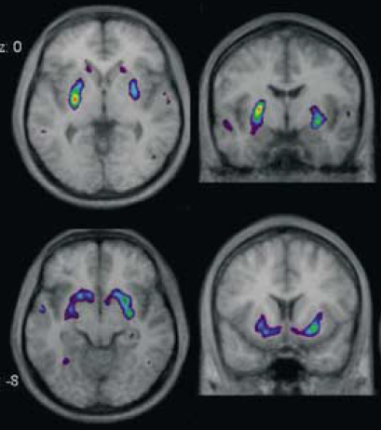
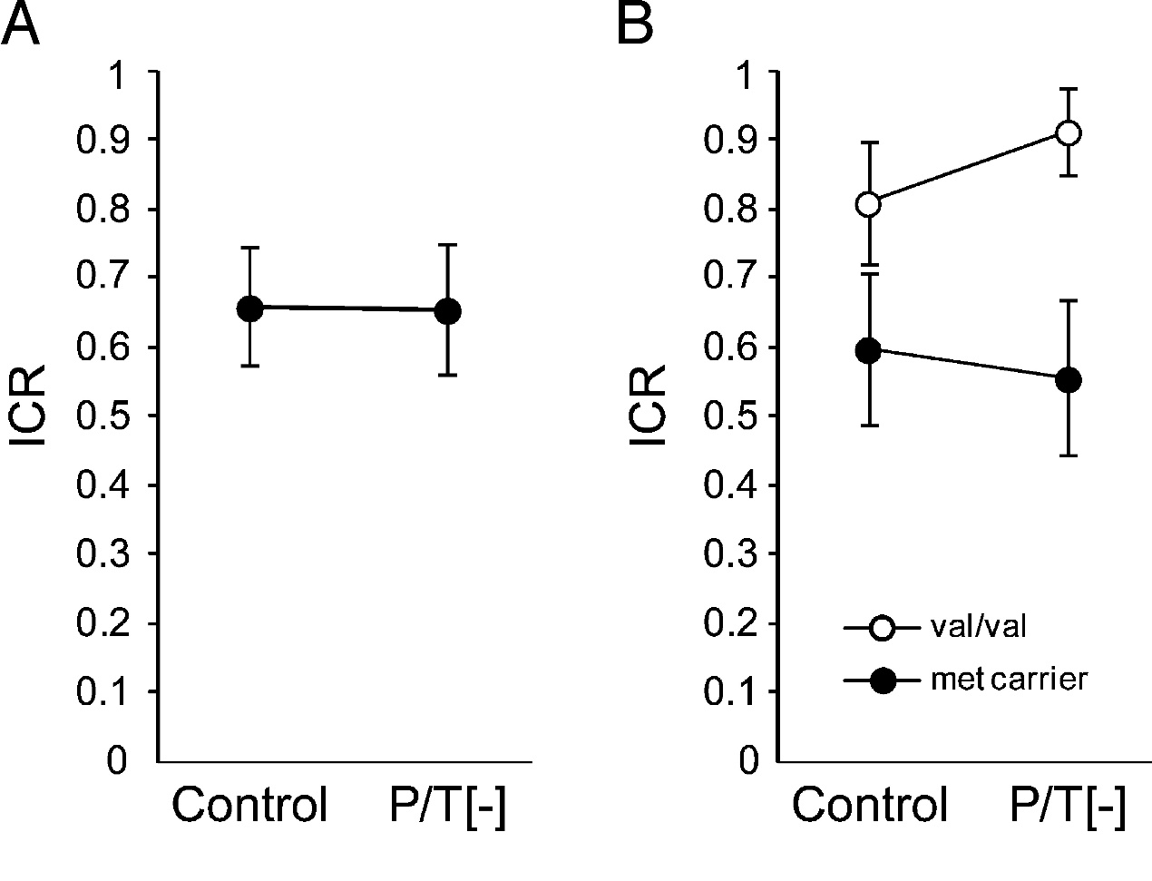
Modulation of ICR within individuals?
Kelm & Boettiger, 2013 (healthy young men, mean age=26, n=15)
Global dopamine depletion via an amino acid beverage deficit in phenylalanine
& tyrosine (P/T-), the necessary perquisites for dopamine synthesis
COMT SNP
Leyton et al, 2004
P/T- reduces DA signaling
measured with PET
DA treatment’s effectiveness
depends on COMT genotype

Slide 18
Implications and Future Directions
If an inverted-U function explains ICR behavior, therapies that intervene to reduce ICR will need to consider where on the curve individuals lie.
  COMT genotype, age, and menstrual cycle/estradiol status may all need to be considered
ICR=0.4
↓DA
(antagonist)
Adults from Smith & Boettiger, 2012
Psychopharmacology
  Epigenetic variation in COMT as explanation of variance?
Swift-Scanlan T, Smith CT, Bardowell SA, Boettiger CA (2014), BMC Medical Genomics
↑COMT Met alleles →↓ COMT methylation
COMT Met carriers: ↑COMT hypomethylation w/ ↓SES, ↑hazardous alcohol use
↑DA
(agonist)
↓ICR
ICR=0.7
ICR=0.7
CH₃
↑ Methylation
↓ COMT enzyme expression
ICR=0.9
CH₃
PFC DA
V/V V/M M/M
COMT
Notes:
The DAT (SLC6A3) VNTR
(Vandenbergh et al. 1992) is located in intron 3 (DAT1)
that modulates transcription (VanNess et al. 2005), midbrain
activation (Schott et al. 2006) and in vivo
transporter availability (van Dyck et al. 2005), with the
10-repeat allele having stronger enhancer-like properties
resulting in higher DA tone than the 9-repeat allele (van
Dyck et al. 2005).
Zhong et al 2009 found that 10/10 individuals are more risk averse than 9 repeat carriers; lower DA tone (e.g. 9-repeat allele of DAT1) yields more risk tolerance in the gain Domain
Other studies found subjects with the 7-repeat allele in the dopamine receptor D4 gene (DRD4) exon 3, hence low DA tone
(Van Craenenbroeck et al. 2005) is more risk-tolerant than subjects without the 7-repeat allele. Both results,
being in the same direction as the current report, corroborate our conjecture that DA tone modulates sensitivity of
valuation over gains.

Slide 19
Positron Emission Tomography & Measurement of Dopamine Signaling in the Human Brain

Slide 20
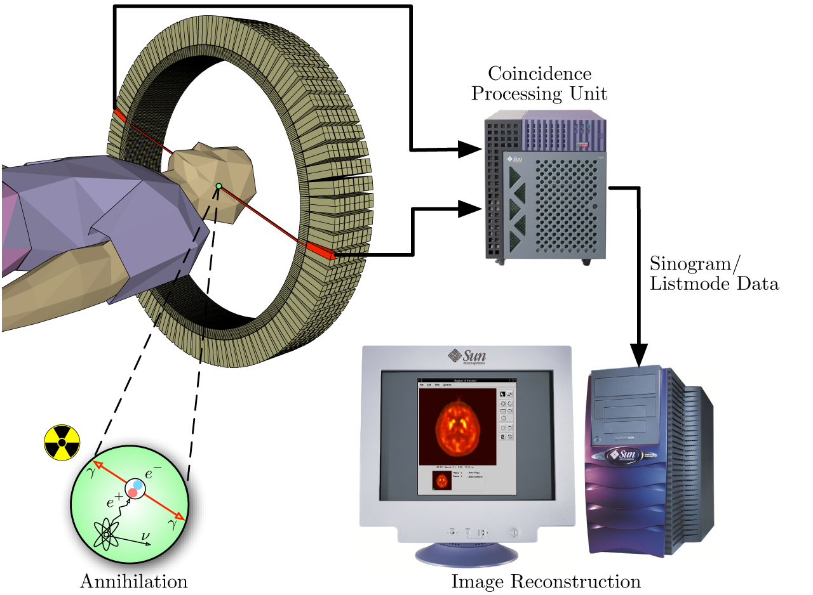
Positron Emission Tomography (PET)
Positron emitting tracer
¹¹C, ¹⁸F

Slide 21
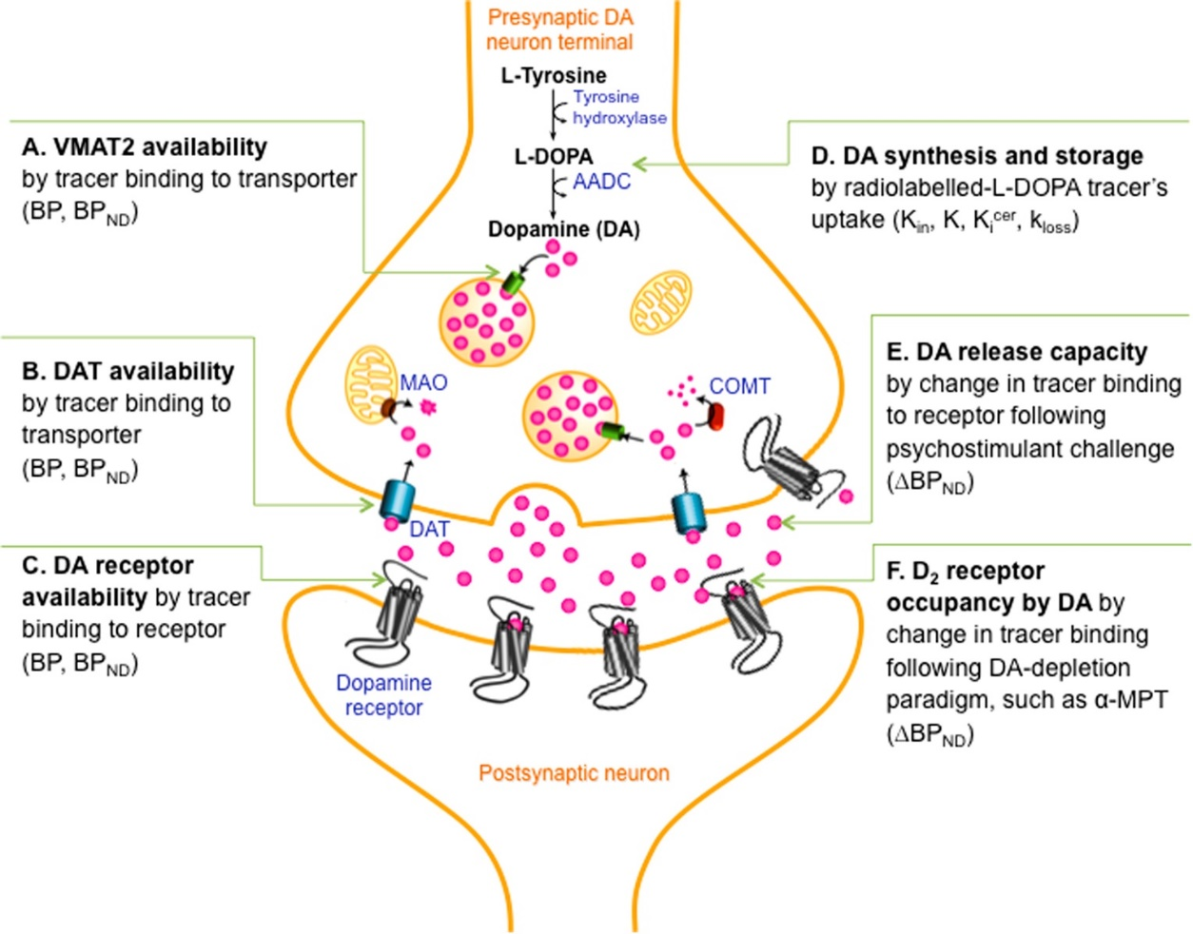
Dopamine system function can be measured at a variety of nodes.
FMT PET
DA Receptors (D2/3)
Weinstein et al., 2017 Biological Psychiatry

Slide 22
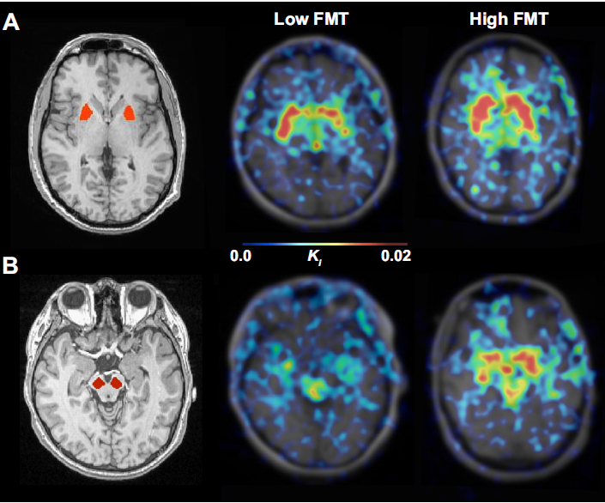
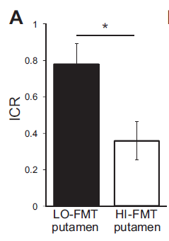
Smith et al., 2016 Journal of Neurophysiology
Modulation of impulsivity and reward sensitivity in intertemporal choice by striatal and midbrain dopamine synthesis in healthy adults
↓ midbrain DA synthesis,
↑ sensitivity to reward magnitude

Slide 23
Dopamine system function can be measured at a variety of nodes.
FMT PET
Change in Fallypride BP_{ND} after dAMPH
DA Receptors (D2/3)
Weinstein et al., 2017 Biological Psychiatry

Slide 24
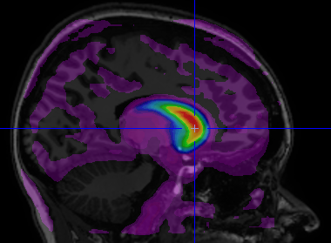
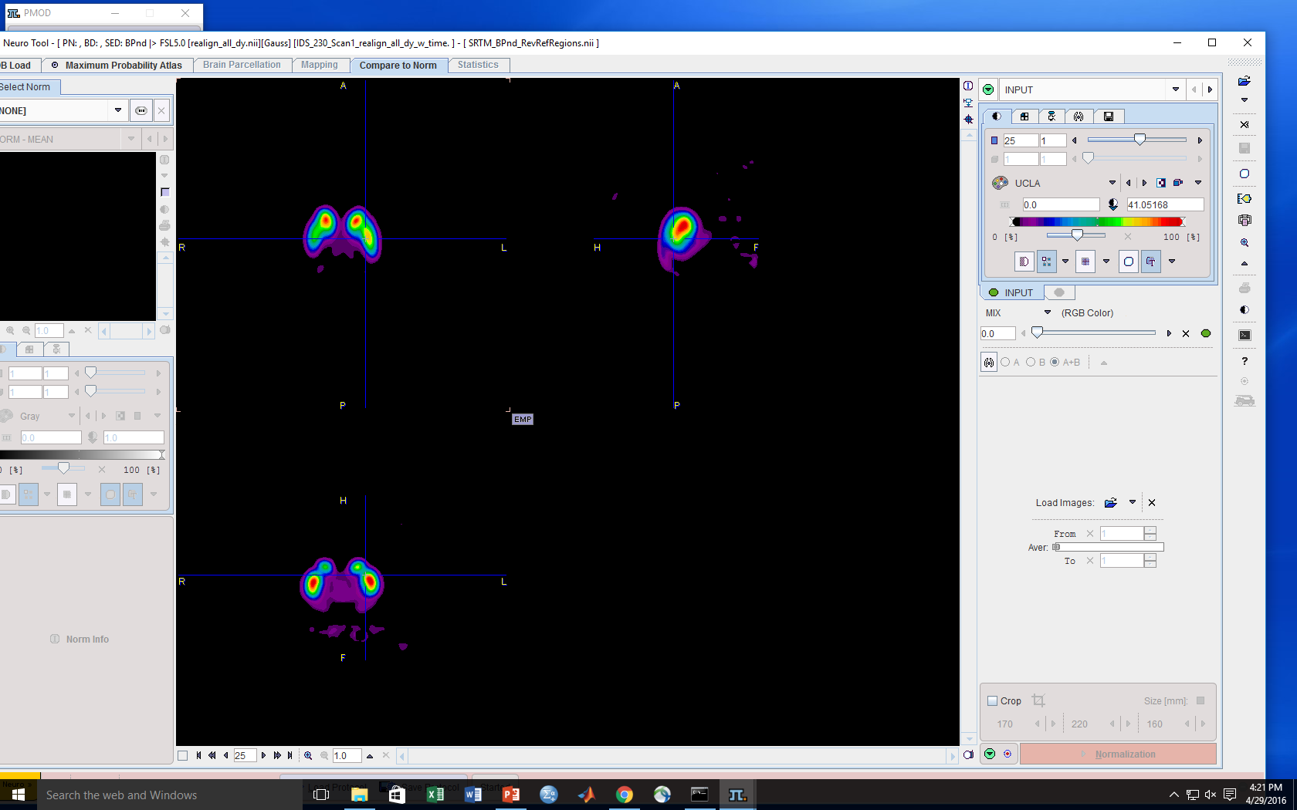
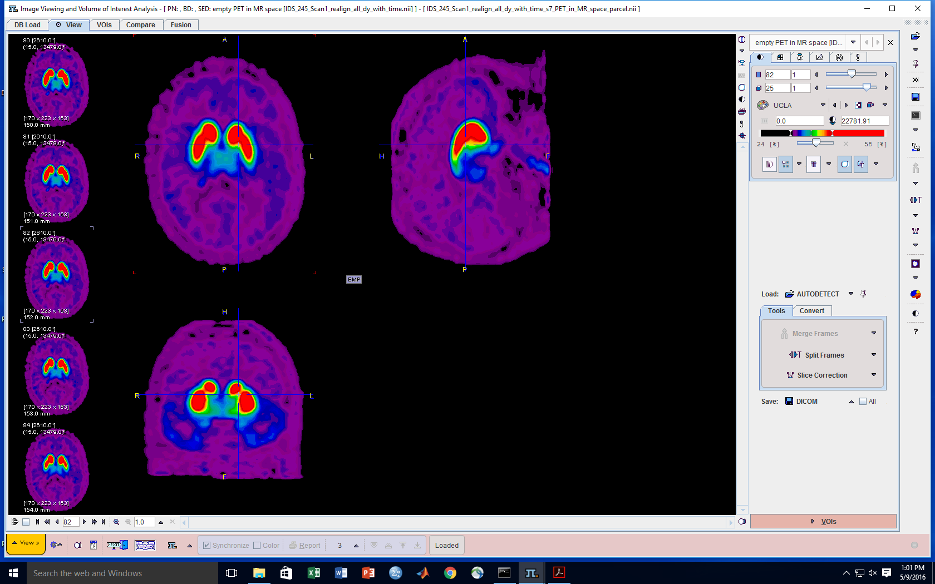
¹⁸F-Fallypride Measures Striatal & Extrastriatal DA D2/3 Receptor Availability (BPnd)
Fallypride: DA D2/3 receptor antagonist
Images DA receptor levels across the brain
100%
Fallypride Signal
50%
The most studied D2/3 PET tracer, ¹¹C-raclopride does not have high enough affinity to measure low, extrastriatal DA receptor levels
BPnd estimation limited to striatum with raclopride
0%
BPnd

Slide 25
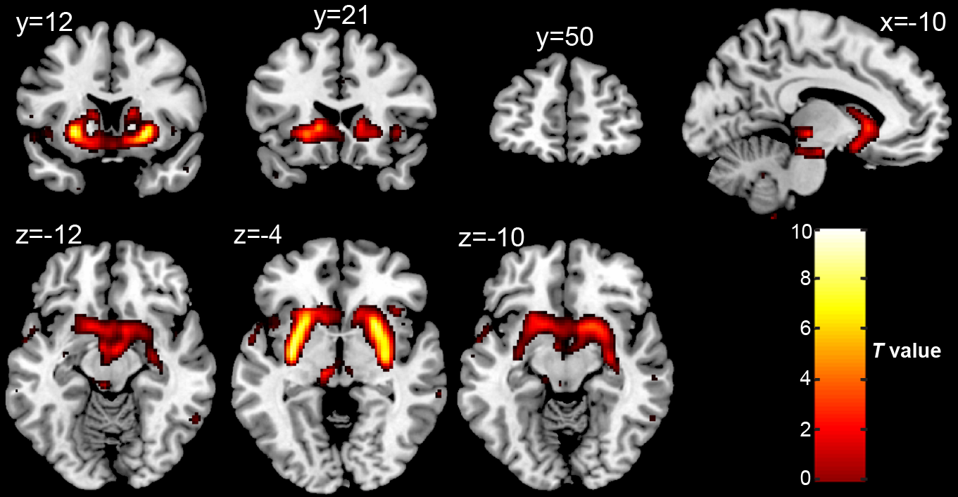
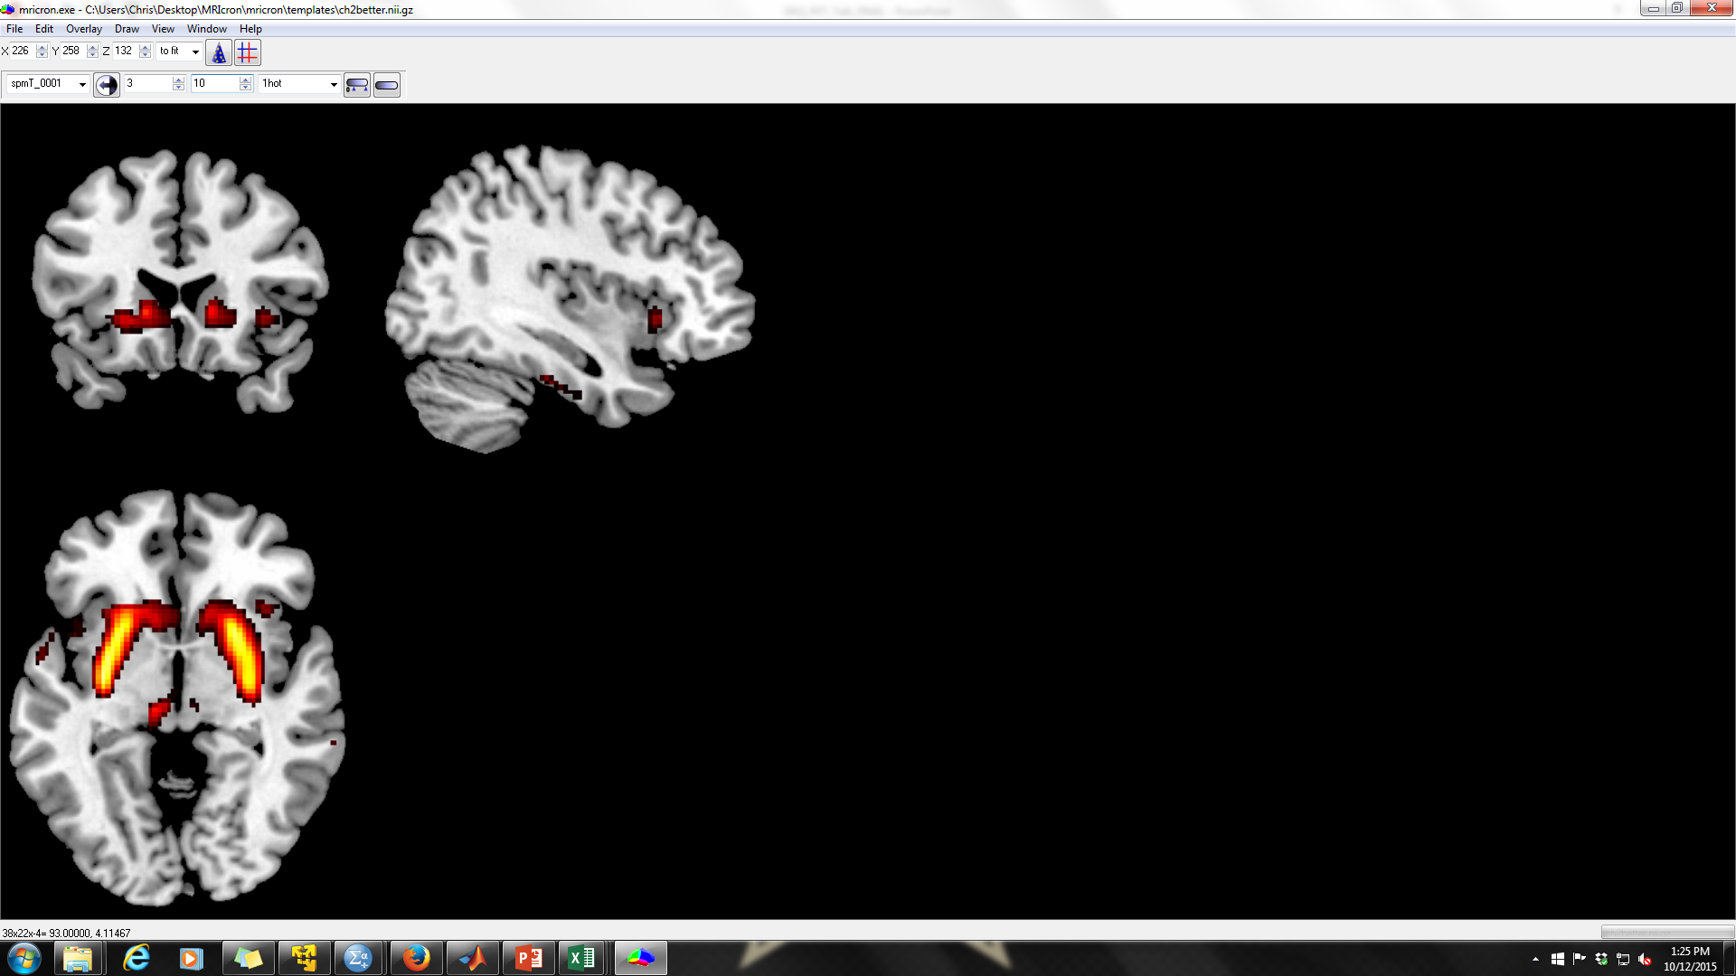
¹⁸F-Fallypride PET can measure d-amphetamine (dAMPH)-induced DA release (%ΔBPnd)
Displaceable by endogenous DA (BPnd declines after dAMPH)
Significant %ΔBPnd
DA release
x=38

Slide 26
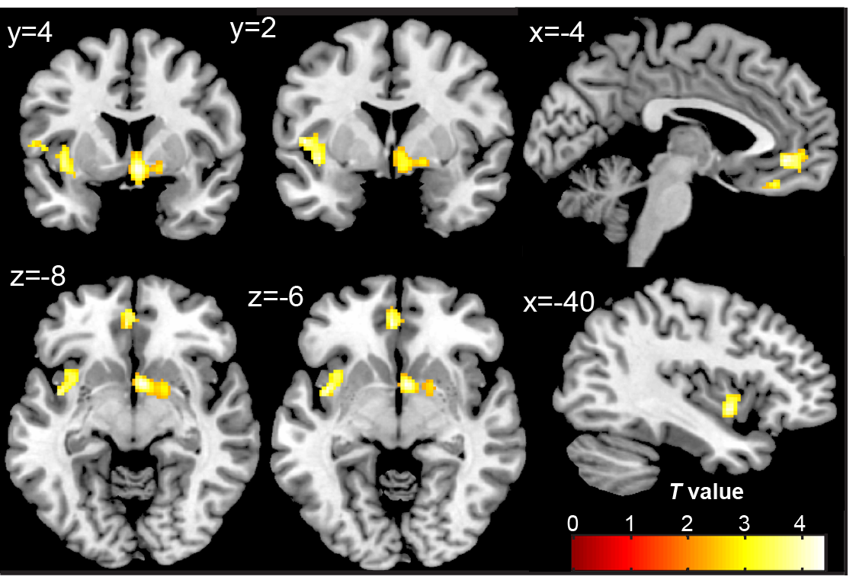
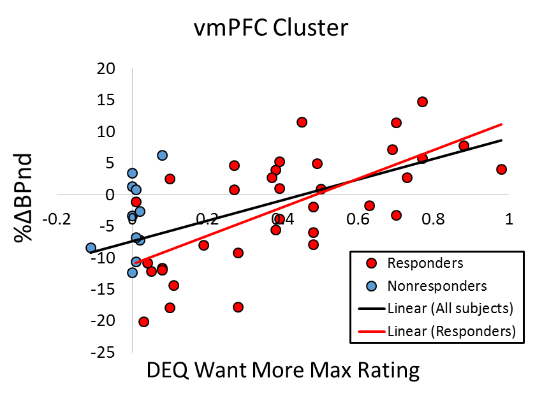
DA release (%ΔBPnd) in the right ventral striatum, left insula, and vmPFC correlates with max “Want More” dAMPH ratings
r=0.68, p<0.001
r=0.57, p<0.001
↑ DA release
Smith et al., 2016 Neuropharmacology Also see: Smith et al., 2016 Journal of Psychopharmacology

Slide 27
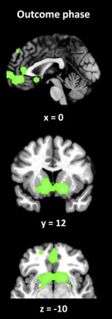
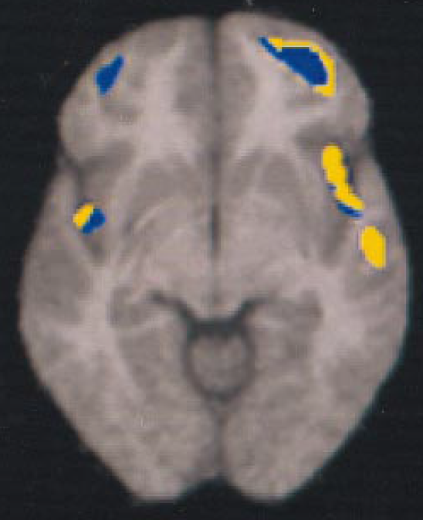
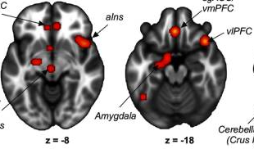
vmPFC, insula, and VS implicated in psychostimulant responses
vmPFC activity ↑ after methamphetamine (Vollm et al., 2004)
vmPFC blood flow correlates with methylphenidate euphoric effects (Udo de Haes et al., 2007)
VS amph injection ↑ wanting not liking in rats (Wyvell & Berridge, 2000)
Insula response correlated with drug craving (Naqvi et al., 2014; Kilts et al., 2001; cocaine)
vmPFC & insula implicated in interoception, sympathetic arousal (Beissner et al., 2013)
vmPFC & VS implicated in subjective valuation, reward processing (Diekhof et al., 2012)
Reward
insula
vmPFC

Slide 28
PET Conclusions & Future Directions
Striatal DA is related to ICR (Now choice bias)
d-AMPH induced DA release is related to drug wanting, not liking in: ventral striatum (reward node), insula (craving node), vmPFC (valuation node)
Understanding individual differences in brain DA may identify individuals at risk for drug addiction via:
  Cognitive/Decision Making processes (Now bias)
  Affective processes (drug wanting)
Differences in brain DA are being investigated at the level genetics, age, personality, and sex

Slide 29




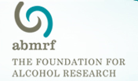

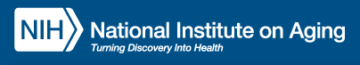
Acknowledgements
UNC Chapel Hill
Charlotte Boettiger, PhD
(PhD Advisor)
  Katie Kelm, PhD
  Michael Parrish*
  Scott Oppler*
Collaborators:
Theresa Swift-Scanlan (VCU)
Andy Smolen (University of Colorado)
Bill Jagust (Lawerence Berkeley National Lab) Deanna Wallace (UC Berkeley)
Linh Dang (UC Berkeley, now Vanderbilt)
Emily Jacobs (UC Berkeley, now UCSB)
    Gregory Samanez-Larkin (Yale, now Duke)
    Ronald Cowan, MD, PhD (Vanderbilt)
    Robert Kessler, MD (UAB)
    Harriet de Wit (Univ of Chicago)
    Jessica Weafer (Univ of Chicago)
    Joshua Buckholtz (Harvard)
    Daniel Claassen (Vanderbilt)
Vanderbilt University
David Zald, PhD
(Postdoc Mentor)
  Linh Dang, PhD
  RAs:
    Scott Perkins
    Jaime Castrellon
    Leah Burgess
    Danica San Juan
    Darcy Smith
Grad Funding: F31AA020132 (CTS) from NIAAA, T32DA007244 (CTS) from NIDA, UL1RR025747 (CAB) and KL2RR025746 (CAB) from NCRR, A14-0050-001 (CAB) from ABMRF.
Postdoc Funding: NIDA: R01DA019670 (DHZ), R21DA033611 (DHZ), F32DA041157 (CTS); NIA: R01AG044838 (DHZ)

