Slide 1
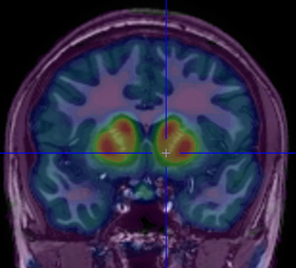
Individual Differences in Choice, Subjective Valuation, and Dopamine Signaling as Potential Markers for Drug Abuse Risk
Chris Smith, PhD
Postdoctoral Fellow, Affective Neuroscience Lab
Department of Psychology, Vanderbilt University
www.christophertsmith.com
XXXX University
February 15, 2018

Slide 2



Training Background: Neuroscience
Animal models of addiction
Furman University (Greenville, SC)
BS, Neuroscience
University of North Carolina at Chapel Hill
PhD, Neurobiology
Advisor: Charlotte A. Boettiger, PhD
Vanderbilt University
Postdoctoral Training
Advisor: David H. Zald, PhD
Human behavior
Endophenotypes
Alcohol Use Disorders
Genetics
functional Magnetic Resonance Imaging (fMRI)
Human behavior
Individual Differences
Genetics
Positron Emission Tomography (PET) of Dopamine System

Slide 3


Overview
  Impulsive Choice (IC) as an endophenotype for alcohol use disorders (AUDs).
  Individual Differences in Dopamine
  2) IC affected by prefrontal & striatal dopamine (DA).
  Genetic proxies of prefrontal & striatal DA signaling.
  Implications for sex and age differences in drug abuse.
  Future Research Directions
  Developing a model.
Drug Abuse/Addiction Risk
Inconsistent GWAS
Studies
Heritability:
0.3-0.7
Dopamine
endophenotype
genetics
Impulsive Choice
Heritability:
0.3-0.5
fMRI
PET
Goal
maintenance
Endophenotype: manifestation of underlying disease liability
PFC
Reward
  Combining knowledge of prefrontal & striatal DA and their modulation to predict IC, drug abuse risk.
Striatum
Fronto-striatal Loops
Critical for reward-driven behavior
Notes:
Drug Abuse Heritability:
Van den Bree et al., 1998 Drug & Alcohol Dependence

Slide 4
Alcohol Use Disorders (AUDs):
Costly, Complex, Poorly Understood
Costs of excessive Alcohol consumption:
  $249 billion (Sacks et al., 2015), 88,000 deaths annually (CDC)
  $300 billion tobacco; $193 billion illicit drugs, $78.5 billion opioids (NIDA)
  18% of Americans will experience AUDs during lifetime (Hasin et al., 2007)
AUDs: Highly heritable (30-60%)
AUDs
Endophenotype
Genetic/biological Risk
Impulsive Choice
Meta analysis effect size: d=0.50
(MacKillop et al., 2011)
Endophenotype: manifestation of underlying disease liability
Notes:
Tobacco: d=0.57
Due to its strong association with addiction, availability of well established animal models,
and relatively well elucidated neural substrates, DD can potentially serve as an intermediate
biobehavioral phenotype that could help bridge the gap between genetic risk factors and
complex psychiatric phenotypes such as substance use or externalizing disorders in which
impulsivity is implicated as a core underlying dysfunction. An important requirement of
such an intermediate phenotype is its heritability. However, little is currently known about
the relative contribution of genetic and environmental factors to individual differences in
DD in humans.
approximately 10% of Americans will suffer from alcoholism¹
30% of alcoholics receive treatment²
only 10% use medication³
1: Grant (1994) Addiction 89:1357-1365
2: Cohen et al. (2007) Drug Alcohol Depend 86:214-221.
3: Mark TL et al. (2003) Drug Alcohol Depend 71:219-228.
Boothby and Doering (2005) Clin Ther 27:695-714.

Slide 5
Impulsive Choice: Choosing Now over Later
A
B
Best short-term choice
Best long-term
choice
“Now”
>
“Later”

Slide 6

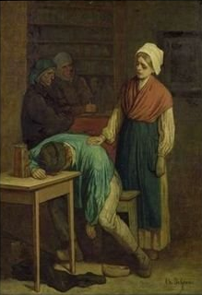


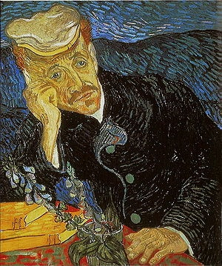
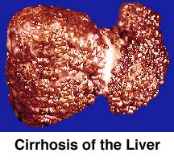
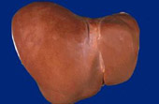
Impulsive Choice:
Relationship to Addiction?
Notes:
Alcohol Use Disorders (AUDs) are complex and heterogenous and can be the result of many precipitating events
Makes study of the neural basis of AUDs difficult
Understanding behavioral markers of possible alcohol use disorders could help in targeting treatment to those in need
To better understand the neurobiology of alcohol use disorders, we study an intermediate behavioral phenotype common to these disorders:
Immediate reward bias (choosing Now over Later)

Slide 7


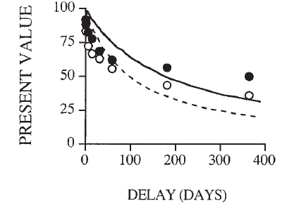
Quantifying Impulsive Choice
Delay Discounting Task
Impulsive Choice Ratio (ICR):
ICR Range:
    more impulsive
    less impulsive
now choices
total choices
NOW
LATER
$70
$100
work w/ Charlotte Boettiger @ UNC
Mitchell et al. (2005); Boettiger et al. (2007)
Delay Times (days) | Now Discount (% of Delayed) | Delay Amount
7 | 70% | 2
14 | 85% | 5
30 | 90% | 10
90 | 95% | 20
180 |  | 100
21 WANT trials per 8-min test block x 8: 168 total trials
1
Calculate slope of time discounting curve (k)
ICR can be conceptualized as a measure of Now/Impulsive choice bias:
↑ICR=↑ Now Bias
0
Notes:
8 blocks of 42 trials: 336 trials
Each ~8 minutes long
ICR correlates with trait impulsivity: r=0.53, p<0.004
(Mitchell et al., 2005)

Slide 8
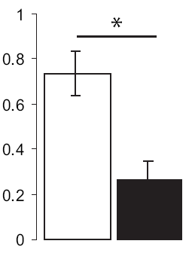
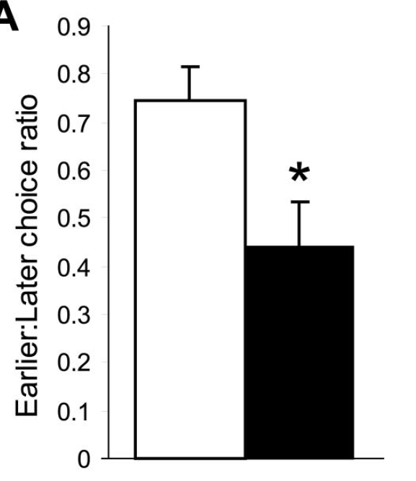

ICR is Elevated in Alcoholics
MacKillop et al., 2011 meta-analysis: Effect sizes (Cohen’s d) comparing Impulsive Choice in Drug-Dependent vs Control Individuals
  Alcohol: d=0.50, Tobacco: d=0.57, Stimulants: d=0.87, Opiates: d=0.76
On the current method of measuring impulsive choice, ↑ICR in Abstinent Alcoholics (Mitchell et al., 2005)
Mitchell et al. (2005)
Boettiger et al. (2007)
Abstinent alcoholics
ICR
Control subjects
ICR
“Healthy” Adult
ICR: 0.3-0.45
Abstinence:
median = 5 months
mean = 2.5 years
Irreversible consequence of chronic alcohol abuse?
Pre-existing risk trait enriched in those with AUDs?
↑ ICR:
Endophenotype?

Slide 9
Criteria for Categorizing a Measure as an Endophenotype
Criteria: Met by ICR?
Good psychometric properties: measure consistent & stable over time
Measure related to the disorder it is associated with (explains symptoms; face validity)
Show increased expression in unaffected relatives of those with the disorder
YES
8 minutes of task sufficient to stably estimate ICR
YES
Not shown sufficiently yet
Endophenotype: manifestation of underlying disease liability
Meyer-Lindenberg & Weinberger, 2006; MacKillop, 2013
Notes:
DD is thought to be ~40% heritable in animals (Wilhelm and Mitchell, 2009) and ~50% in humans – 12-14 yr old adolescent twin pairs presented with one “real” Now vs Later choice ($7 today or $10 in a week?) (Anokhin et al., 2011)
The preference for immediate but smaller rewards may be a behavioral marker of underlying
genetic liability to impaired decision making and could serve as a useful endophenotype for
genetic studies of the etiology of substance use disorders. The finding of genetic influences
on this behavioral phenotype raises the question about genetic influences on specific neural
substrates underlying intertemporal choices. These issues need to be addressed in future
studies using cognitive brain electrophysiology and/or functional neuroimaging methods in
genetically informative designs.

Slide 10
ICR: Endophenotype for AUDs
FH+: Family History (1° relatives) Positive
η²=0.366
FH-: Family History Negative
“Healthy” Adult
ICR: 0.3-0.45
Mitchell et al., 2005; Smith et al., Frontiers in Human Neuroscience 2015
Notes:
Ns are 14, 13, 16, and 7, respectively

Slide 11
Criteria for Categorizing a Measure as an Endophenotype
Criteria: Met by ICR?
Good psychometric properties: measure consistent & stable over time
Measure related to the disorder it is associated with (explains symptoms; face validity)
Show increased expression in unaffected relatives of those with the disorder
Sufficiently Heritable (genetic basis)
  Anokhin et al., 2011: IC Heritable (0.3-0.5)
YES
YES
↑ICR in adults with 1° family members with an AUD
Role of COMT ?
Boettiger et al., 2007
Meyer-Lindenberg & Weinberger, 2006; MacKillop, 2013
Notes:
DD is thought to be ~40% heritable in animals (Wilhelm and Mitchell, 2009) and ~50% in humans – 12-14 yr old adolescent twin pairs presented with one “real” Now vs Later choice ($7 today or $10 in a week?) (Anokhin et al., 2011)
The preference for immediate but smaller rewards may be a behavioral marker of underlying
genetic liability to impaired decision making and could serve as a useful endophenotype for
genetic studies of the etiology of substance use disorders. The finding of genetic influences
on this behavioral phenotype raises the question about genetic influences on specific neural
substrates underlying intertemporal choices. These issues need to be addressed in future
studies using cognitive brain electrophysiology and/or functional neuroimaging methods in
genetically informative designs.

Slide 12
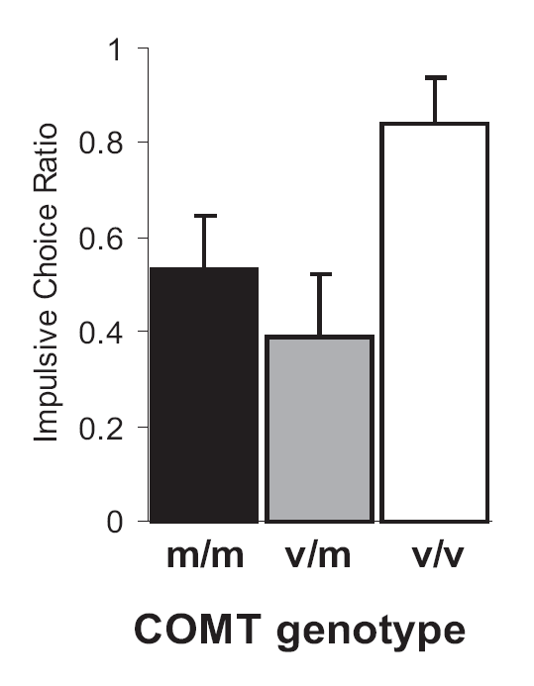
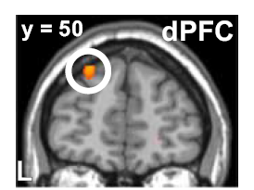
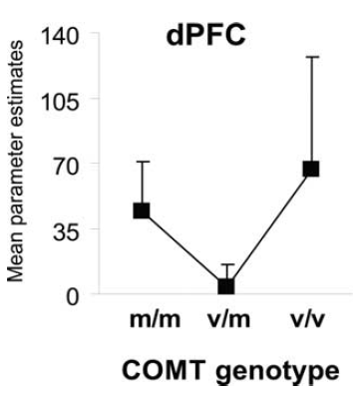
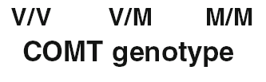
Genetics of Impulsive Choice
$70
$100
ICR
fMRI: brain activation during choice
↑dPFC activity=↑ICR
r=0.68, p<0.001
Healthy Control
Level
dPFC activity
Greater
efficiency
N=7
N=10
N=8
From Boettiger et al., 2007
ICR is related to genetic variation (SNP) in the catechol-O-methyltransferase enzyme (Val158Met; rs4680).
Neural activity (WANT>Control) in dorsal Prefrontal Cortex (dPFC) correlates with ICR
and varies as function of COMT Val158Met SNP.
Notes:
SNP at codon 158 of the COMT gene

Slide 13
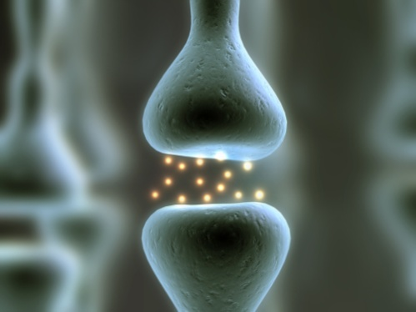
What is catechol-O-methyltransferase (COMT)’s function in Prefrontal Cortex?
Val/Val COMT
Met/Met COMT (recently evolved)
Tyrosine
TH
Effect confirmed in DA PET study (Wu et al., 2012)
L-DOPA
AADC
Dopamine
DAT
Dopamine
DAT
COMT
COMT
TH: tyrosine hydroxylase
AADC: aromatic amino acid decarboxylase
DAT: dopamine transporter
3-MT: 3-methoxytyramine
DA
3-MT
PFC DA
Notes:
Make point that there are very little to no DA transporters in the PFC
DA neurons projecting to the PFC have higher baseline firing and higher rate of dopamine turnover than other DA neurons
projecting to the striatum (Thierry et al., 1976;Tam et al., 1990)
The PFC contains significantly less dopamine transporter protein than other brain regions (Sanchez-Gonzalez & Cavada, 2003 (monkey) and Sesack et al, 1998 (rat))
This results in the enzyme catechol-O-methyltransferase (COMT) being the primary means of DA clearance in the PFC (accounts for 60% of clearance in PFC) (Karoum et al., 1994)
A single base-pair substitution of G for A at residue 158 of the COMT gene results in the substitution of Met for Val at this residue
The Met polymorphism lowers the efficacy of the COMT enzyme such that it degrades DA at only 25% the rate of the Val variant (Lotta et al., 1995; Lachman et al., 1996)
COMT functional polymorphism
Ancestral – Val
Novel form (new to humans) – Met
MetMet Degrades DA at 1/4th rate of Val/Val polymorphism
So, for MetMet, DA persists in extracellular space longer (DA’s action prolonged)
↑ PFC DA in MetMet → ↑ performance on frontal-dependent cognitive tasks
(Egan et al., 2001; Goldberg et al., 2003; Mattay et al., 2003; Diamond et al., 2004; Nolan et al., 2004)
The Met/Met COMT polymorphism (resulting in high levels of extracellular PFC dopamine) is associated with better performance on many frontal-dependent cognitive tasks (Iowa gambling task, working memory tasks, attentional control tasks, Wisconsin Card Sorting Task (Egan et al., 2001; preservative errors) etc…)
In Egan paper, Val/Val individuals had significantly higher activity in dorsolateral PFC (dPFC) and more preservative errors than other COMT genotypes

Slide 14
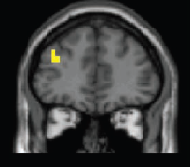
Genetics of Impulsive Choice: COMT, Intermediate PFC DA, & Low ICR
Fits with our understanding of COMT effects on dPFC-dependent working memory.
(Mattay et al., 2003)
fMRI activity
Efficient Processing
Optimum
Low ICR
V/M
M/M
Efficient
Processing
Monkey electrophysiology
DA ↑ signal-to-noise in PFC neurons
(Vijayraghavan et al., 2007)
V/V
↓accuracy
ICR
High ICR
M/M
Healthy Control
Level
PFC DA
Optimum Working Memory
More Efficient dPFC Processing
V/V
↑DA w/ dAMPH
N=7
N=10
N=8
PFC DA
PFC DA
dAMPH: d-amphetamine (Adderall)

Slide 15
Further Support for U-Shaped Model: COMT x Age Effects
Alcohol Use
Disorder Risk
COMT enzyme activity in dorsal PFC increases into adulthood (Tunbridge et al., 2007)
DA signaling declines with age (Karrer et al., 2017)
Hypothesis: Age should impact the relationship
between COMT Val158Met genotype and ICR.
Dopamine
Impulsive Choice
Endophenotype
genetics
Val/Val ICR increases with age
Met/Met ICR decreases with age
COMT Val158Met SNP
Optimum
Low ICR
Correlate age and ICR:
ValVal (n=40):
r=0.32, p=0.047
Met carriers (n=102):
r=-0.31, p=0.001
Age groups
old
young
PFC DA
Age:
↓DA
High ICR
PFC DA
Smith and Boettiger, Psychopharmacology 2012

Slide 16

Further Support for U-Shaped Model:
COMT x Sex Effects
COMT enzymatic activity is consistently lower in females (Chen et al., 2004)
Hypothesis: Sex will influence the effects of COMT Val158Met on ICR.
U-shaped effects were also observed in fMRI measures of resting-state and task-based brain connectivity.
Males
Females
Optimum
Low ICR
ICR
High ICR
PFC DA
From Chen et al., 2004
Avg group n=14
n range 8-27
DA
↑ COMT activity: ↓ PFC DA
↓ COMT activity: ↑ PFC DA
PFC DA
Elton, Smith, et al., Frontiers in Human Neurosci 2017
Notes:
Avg group size: 14
Smallest n=8
Largest n=27
In all models, COMT genotype effects covaried for age, socioeconomic status, menstrual cycle phase (categorically-defined to include women in cycle days 1–7, 8–15, and 18–30), and current hormonal birth control usage (binary).

Slide 17
Implications of a U-Shaped Relationship
If an inverted-U function explains ICR, therapies that seek to reduce ICR will need to consider where on the curve individuals lie.
COMT inhibitor Tolcapone
(Kayser et al., 2012)
↑PFC DA
Low
ICR
0.4
Optimal
↓DA
(antagonist)
↑DA
(agonist)
0.7
Beneficial for low PFC DA individuals
High
ICR
1.0
Sub/Supra-optimal
PFC DA
Notes:
The DAT (SLC6A3) VNTR
(Vandenbergh et al. 1992) is located in intron 3 (DAT1)
that modulates transcription (VanNess et al. 2005), midbrain
activation (Schott et al. 2006) and in vivo
transporter availability (van Dyck et al. 2005), with the
10-repeat allele having stronger enhancer-like properties
resulting in higher DA tone than the 9-repeat allele (van
Dyck et al. 2005).
Zhong et al 2009 found that 10/10 individuals are more risk averse than 9 repeat carriers; lower DA tone (e.g. 9-repeat allele of DAT1) yields more risk tolerance in the gain Domain
Other studies found subjects with the 7-repeat allele in the dopamine receptor D4 gene (DRD4) exon 3, hence low DA tone
(Van Craenenbroeck et al. 2005) is more risk-tolerant than subjects without the 7-repeat allele. Both results,
being in the same direction as the current report, corroborate our conjecture that DA tone modulates sensitivity of
valuation over gains.

Slide 18
Revisiting ICR as an Endophenotype for Alcohol Use Disorders
ICR Appears to be a Useful Endophenotype for AUDs in 26-40 year old adults
Linear fit
Data trend
Normal Brain Maturation Reduces ICR
Criteria: Met by ICR?
0.75
Heavy Drinkers:
r=-0.025, p=0.39
Good psychometric properties: measure consistent & stable over time
Measure related to the disorder it is associated with (explains symptoms)
Show increased expression in unaffected relatives of those with the disorder
Sufficiently Heritable (genetic basis)
YES
Alcohol consumption (AUDIT-c) correlates positively with ICR in adults (26-40): r=0.40, p=0.007
ICR
YES
All subjects:
r=-0.134, p=0.019
(1.2% per year)
↑ICR in adults with 1° family members with an AUD
0.40
Light Drinkers:
r=-0.276, p=0.003
(2.2% per year)
age
COMT modulates ICR via an inverted-U function
18
26
40
Smith et al., Frontiers in Human Neurosci 2015
*all analyses controlled for COMT x age effects; Total n=237, ages 18-40
Notes:
ICR in 18-21 year olds: 0.75
18-24 year olds: 0.70
Light drinking adults, 26-40: 0.40
Age, ICR correlations from Frontiers paper:
All subjects: r=-0.134, p=0.019
Non-problem drinkers: r=-0.276, p=0.003
Problem drinkers (AUDIT scores >=8 M, >=5 F): r=-0.025, p=0.39
In adults 26-40, each additional AUDIT-c point was associated with a 15.6% increase (β = 0.117) in ICR

Slide 19
Interim Summary
ICR is an endophenotype for AUDs, especially in adults, ages 26-40.
ICR is related to putative measures of PFC DA according to an inverted-U model, affected by age, genetics, and sex.
Alcohol Use
Disorder Risk
η²=0.366
ICR
Dopamine
Impulsive Choice
Endophenotype
genetics
“Healthy” Adult
ICR: 0.3-0.45
COMT Val158Met SNP
Optimum
Low
ICR
High
ICR
AUD Risk ≈ ICR =
f(PFC DA * (age + sex) + brain maturation + alcohol use)
DA depletion affects ICR according to COMT genotype (inverted-U model) in young men (within-subjects; Kelm & Boettiger, 2013)
PFC DA
ICR(PFC DA)=ax²+bx+c (quadratic, where x = COMT genotype)
Notes:
Kelm & Boettiger
(healthy young men, mean age=26, n=15)
Global dopamine depletion via an amino acid beverage deficit in phenylalanine
& tyrosine (P/T-), the necessary perquisites for dopamine synthesis

Slide 20
Role of Striatal Dopamine?
Optimum
Low
ICR
Alcohol Use
Disorder Risk
High
ICR
Striatal
Dopamine?
PFC DA
PFC
Impulsive Choice
Endophenotype
genetics
COMT
as proxy
Striatum
Fronto-striatal Loops
Critical for reward-driven behavior
PFC
Ventral
Striatum
Kable & Glimcher, 2007
Intertemporal Choice Valuation in Brain (fMRI)
DAT Availability

Slide 21

Low Striatal D2/3 Receptor Availability Associated with Drug Abuse/Dependence
Drug Abuser
Control
Humans: Volkow et al., 2004
Non-human primates: Nader et al., 2006 Rodents: Dalley et al., 2007
From
Volkow et al, 2004
Cocaine
Drug Abuse
Meth
ICR
Low striatal DA
Striatal DA?
Heroin
Impulsive Choice
Endophenotype
genetics
Striatal DA
Does reduced striatal DA signaling relate to high ICR (endophenotype for alcohol use disorders)?
Alcohol
PET
D2/3

Slide 22
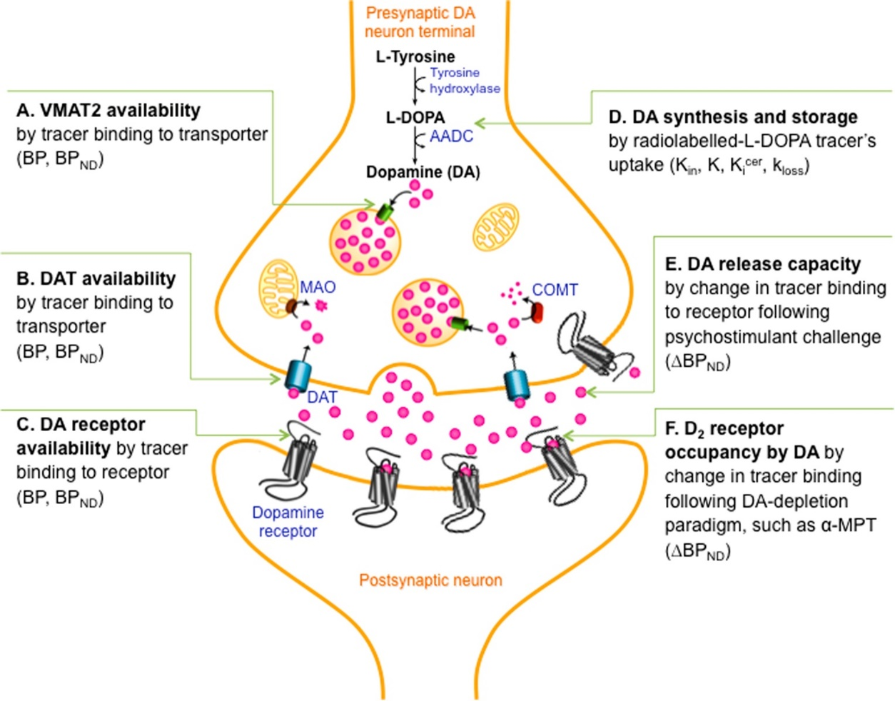
Assessing dopamine system with PET:
Many potential targets
FMT PET
FE-PE2I BPnd
Change in Fallypride BPnd after dAMPH
Fallypride & FLB
D2/3R BPnd
Weinstein et al., 2017 Biological Psychiatry

Slide 23
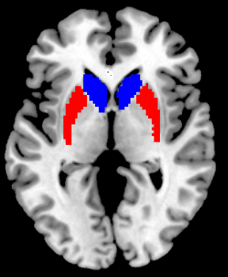
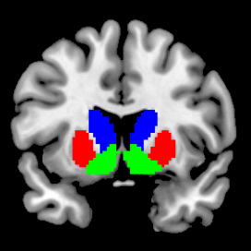
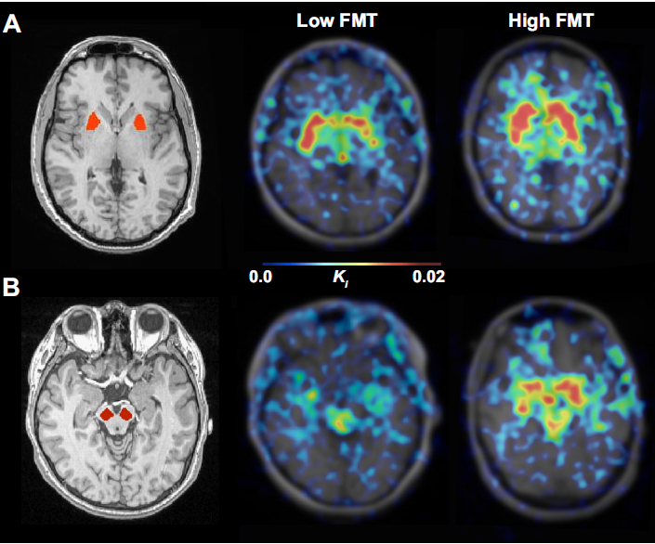


Dopamine Synthesis, Measured with FMT PET, Varies Across Individuals
Striatal Subregions
Caudate
Putamen
Ventral
Striatum
FMT PET
DA Synthesis
Tyrosine
TH
L-DOPA
Putamen
AADC
Dopamine
Collaboration w/ Bill Jagust, Linh Dang
(UC Berkeley)
TH: tyrosine hydroxylase
AADC: aromatic amino acid decarboxylase
Midbrain (VTA/SN DA cell bodies)

Slide 24
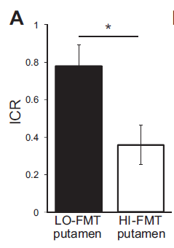
Low Putamen DA Synthesis Capacity is Associated with Greater ICR (Now Bias)
*Controlling for COMT genotype
Healthy Control
Level
Correlation between putamen FMT & ICR:
r=-0.51, p=0.06
n=8
n=8
η²=0.27
Smith et al., Journal of Neurophysiology 2016
Notes:
Controlled for COMT genotype & sex

Slide 25
Low striatal DA signaling relates to greater impulsivity
Optimum
Low
ICR
High
ICR
PFC
Impulsivity
(ICR, trait)
PFC DA
Striatum
COMT as proxy
Striatal DA
Genetic proxy?
Notes:
N=21

Slide 26
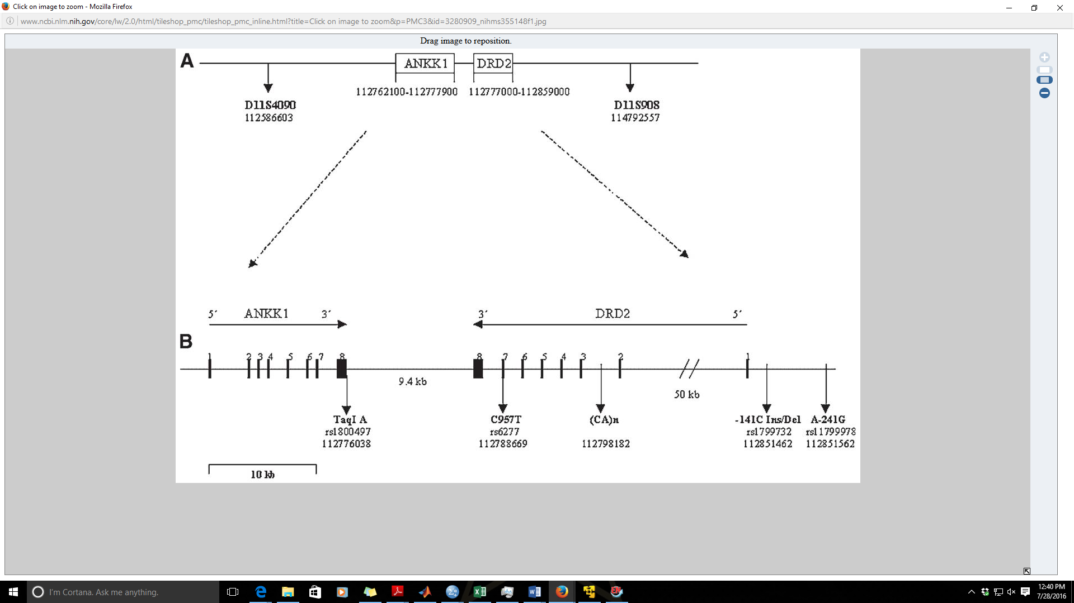
Genetic Markers of Striatal DA Transmission
PET is expensive, not feasible for adolescents (age <18), or available at many research institutions.
Genetic proxies for PET measures of DA are useful.
Effects of common SNPs in D2 receptor gene (DRD2):
Taq1A, C957T, & -141C Ins/Del investigated with PET measures of D2 receptor availability require further study.
Hill et al., 2008
Affects DRD2 protein levels, mRNA stability in vitro
(Duan et al., 2003)

Slide 27
The C957T SNP Affects Striatal D2/3 Receptor Availability (BPnd) in Humans as Measured with PET
Limited to measuring signal only in striatum
Striatal BPnd
TT CT CC
Hirvonen et al., 2004; 2005

Slide 28
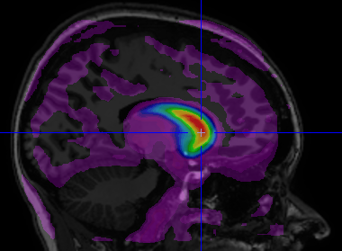
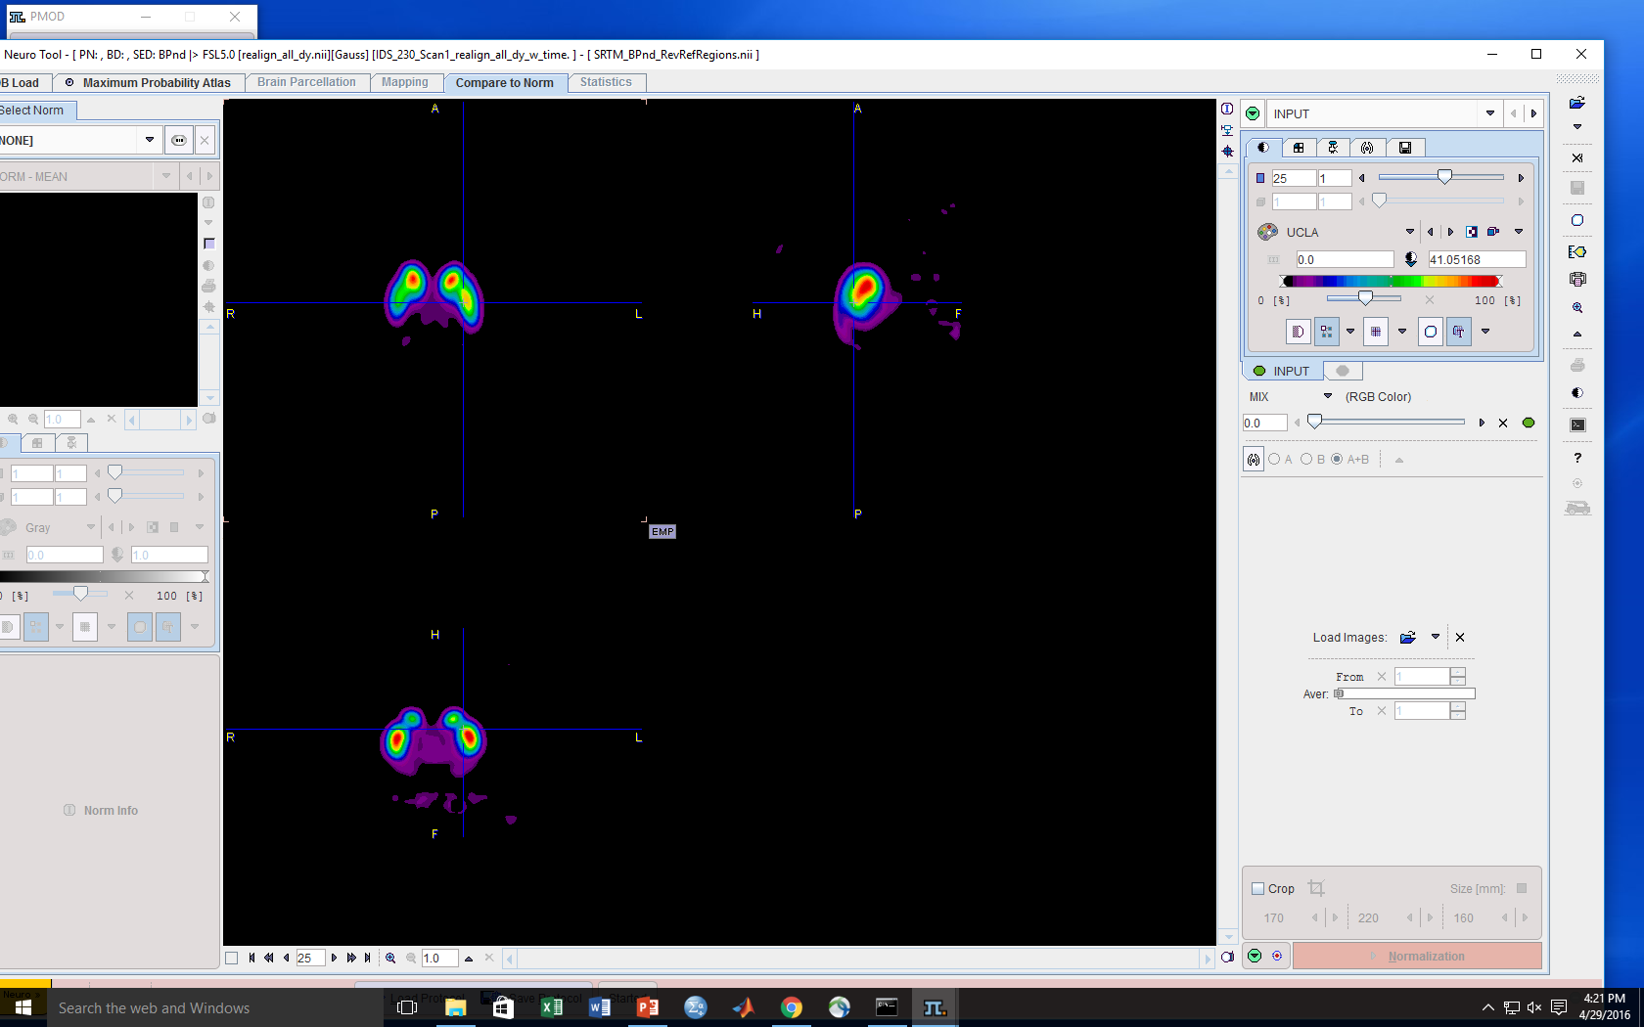

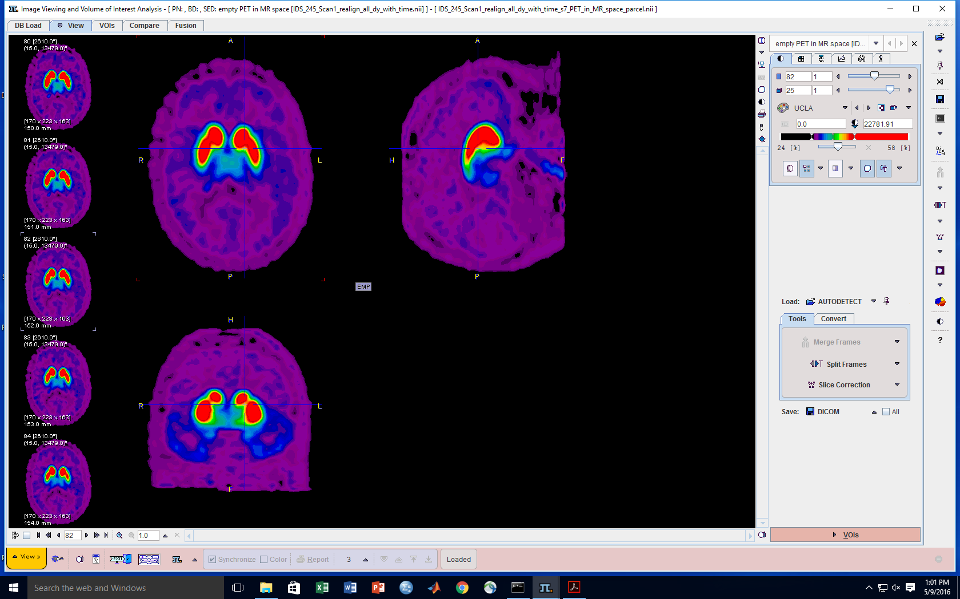
¹⁸F-Fallypride Measures Striatal & Extrastriatal DA D2/3 Receptor Availability (BPnd)
Fallypride: DA D2/3 receptor antagonist
High affinity: Images DA receptor levels across the brain
PET
100%
Can measure effects of DRD2 SNPs on D2/3 receptor availability outside striatum
Extend work of Hirvonen et al., 2004; 2005
Fallypride Signal
50%
0%
BPnd
Work with David Zald & Linh Dang @ Vanderbilt
Measureable by Hirvonen et al.
Limited to striatum

Slide 29
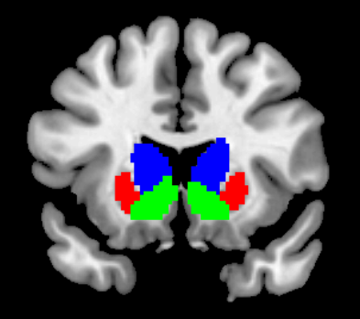
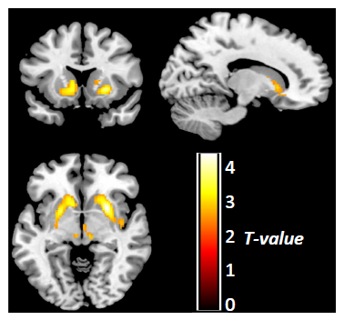
C957T SNP (rs6277) in DRD2 Affects D2/3 BPnd in Ventral Striatum (VS) & Putamen
No evidence for an effect on D2/3 receptors outside striatum.
Caudate
Putamen
Ventral
Striatum
R²=0.065
R²=0.185
Voxelwise result
PET
**
**
#
#
**
**
#
*
*
30
40
14
Confirmed Hirvonen et al., 2004; 2005 effects
**p<0.01, *p<0.05, #p<0.10, controlling for age and sex
Smith et al., Translational Psychiatry 2017

Slide 30
Next Steps
Drug
Abuser
Control
Drug Abuse
From
Volkow et al, 2004
D2/3
C957T CC ?
TT
CC
Low D2/3 availability
Impulsive Choice
Endophenotype
genetics
  Is C957T C allele associated with increased impulsivity?
  Drug abuse risk? Explained by effects on impulsive choice?
  Are its effects age or sex-dependent?
  Swagell et al., 2012: CC associates w/ alcohol dependence in males
Notes:
Swagell:
The C-allele and C/C genotype of C957T was associated with alcohol dependence, whereas the TaqIA polymorphism was not. When analyzed separately for C957T, males showed an even stronger association with the C-allele and females showed no association. -Also found effects of Taq1A and C957T haplotype on increasing risk for alcohol dependence

Slide 31
Summary: Striatal DA
Low DA synthesis in putamen is associated with high ICR (controlling for COMT genotype)
C957T C allele associated with low D2/3 receptor availability in striatum
Age-related declines in D2/3 receptor availability vary by brain region (Smith et al., 2017 JCBFM)
Impulsivity
(ICR, trait)
η²=0.27
ICR(striatal DA)=-(m*age)y+c
Linear, where y=C957T genotype
m (slope) depends on brain region
C957T as proxy
CC
TT
Striatal DA

Slide 32
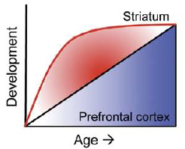
Integrating Modulators of PFC and Striatal DA to Understand Impulsivity and Addiction Risk
State Factors (changeable)
Low ICR
Addiction Risk
Addiction risk(ICR)=
f (DA(striatum+PFC) * age * sex + hormones + stress + drug use + E)
PFC
PFC
Impulsivity
(ICR, trait)
Striatum
Striatal
E=environment
Dopamine
C957T
COMT
Epigenetic Effects: COMT methylation
(Swift-Scanlan, Smith, et al., 2014)
COMT Met carriers: ↓ methylation associated w/ ↓SES, ↑hazardous alcohol use
Impulsive Choice
Endophenotype
genetics
PFC DA
Striatal DA
Low
ICR
Adult
(PFC dominates)
Adolescent
(Striatum dominates)
High
ICR
DA
DA
Casey and Jones, 2010
  How do PFC and striatal DA interact to affect impulsivity?
  How does age/development influence these relationships?
Notes:
For individuals aged 26-40:
What predicts ICR?
Sex: Beta=-0.526, p=0.001 (less for females)
AUDIT-c: Beta=0.312, p=0.027 (more for high consumption)
Ages 18-25:
COMT: Beta=-0.214, p=0.012 (lower with Met dosage)
All subjects:
COMT: Beta=-0.231, p=0.002 (lower with Met dosage)
Age: Beta=-0.181, p=0.014 (lower with increasing age)
Sex: Beta=-0.169, p=0.021 (less for females)

Slide 33

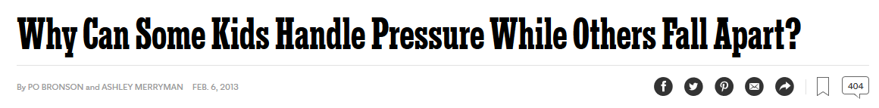
  How do hormones influence these relationships?
Low ICR
ICR
Stress ↑ DA
Stress effects on ICR may be dependent on where on the inverted-U function an individual lies.
Impacted by age, genetics (COMT), sex, estradiol…
C957T
COMT
Females
PFC DA
Striatal DA
Progesterone?
Low
ICR
High estradiol
V/V
STRESS
STRESS
M/M
STRESS
High
ICR
Adult
Adolescent
Menstrual Cycle
DA
DA
DA
COMT enzymatic activity is reduced by estradiol (Jiang et al., 2003)
Estradiol modulates ICR based on COMT genotype: ↑estradiol:↓ICR in Val Carriers (Smith et al., 2014 J Neurosci)
Notes:
For individuals aged 26-40:
What predicts ICR?
Sex: Beta=-0.526, p=0.001 (less for females)
AUDIT-c: Beta=0.312, p=0.027 (more for high consumption)
Ages 18-25:
COMT: Beta=-0.214, p=0.012 (lower with Met dosage)
All subjects:
COMT: Beta=-0.231, p=0.002 (lower with Met dosage)
Age: Beta=-0.181, p=0.014 (lower with increasing age)
Sex: Beta=-0.169, p=0.021 (less for females)

Slide 34
Future Directions
Acute Stress Effects on ICR*
  Moderating effect of genetics, sex?
  Support for inverted-U function based on COMT genotype (Buckert et al., 2012: working memory)
  Effects of Chronic Stress?
Further Investigate Hormone Effects on ICR*
  Effects of estradiol, progesterone, testosterone, cortisol
  Genetic mediators of effects?
    ICR as AUD Endophenotype: Longitudinal Studies
    Other Potential Endophenotypes
* future fMRI studies
  Subjective effects to drugs of abuse, genetic predictors of DA release
  (Smith et al., 2016: J Psychopharm; Neuropharmacology)
  Reward Magnitude Sensitivity (Smith et al., in revision)
Notes:
Data on COMT-dependent U-shaped effects of stress on PFC function (working memory; Buckert et al., 2012)
C957T-dependent effects of stress on motor impulsivity (faster RTs when selecting smaller, sooner rewards; White et al., 2009)
Acute stress increases reward-related impulsivity in CC individuals
-quicker when selecting smaller, sooner rewards in a DD task
(White at al., 2009)

Slide 35
Concluding Remarks
Alcohol Use
Disorder Risk
Addiction Risk
PFC
Striatum
Dopamine
Impulsive Choice
Endophenotype
Genetics
Biology
Endophenotypes
Addiction risk(ICR)=
f (DA(striatum+PFC) * age * sex + hormones + stress + drug use + environment + (gene x environment))
Genetics: Future multilocus or polygenic analyses
Goals: 1) Understand drivers of risk: Develop better treatments
2) Predict addiction risk: Intervene early, strategically

Slide 36



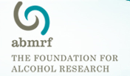

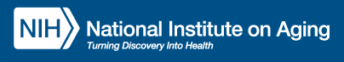
Acknowledgements
UNC Chapel Hill
Charlotte Boettiger, PhD
(PhD Advisor)
  Amanda Elton, PhD
  Katie Kelm, PhD
  Michael Parrish*
  Scott Oppler*
  *undergraduate students
Collaborators:
Theresa Swift-Scanlan (VCU)
Andy Smolen (University of Colorado)
Bill Jagust (Lawerence Berkeley National Lab) Deanna Wallace (UC Berkeley, now UCSF)
Linh Dang (UC Berkeley, now Vanderbilt)
Emily Jacobs (UC Berkeley, now UCSB)
    Gregory Samanez-Larkin (Yale, now Duke)
    Ronald Cowan, MD, PhD (Vanderbilt)
    Robert Kessler, MD (UAB)
    Harriet de Wit (Univ of Chicago)
    Jessica Weafer (Univ of Chicago)
    Abraham Palmer (UCSD)
    Joshua Buckholtz (Harvard)
    Daniel Claassen (Vanderbilt)
    Lea Davis (Vanderbilt)
Vanderbilt University
David Zald, PhD
(Postdoc Mentor)
  Linh Dang, PhD
  RAs:
    Scott Perkins
    Jaime Castrellon
    Leah Burgess
    Danica San Juan
    Darcy Smith
Grad Funding: F31AA020132 (CTS) from NIAAA, T32DA007244 (CTS) from NIDA, UL1RR025747 (CAB) and KL2RR025746 (CAB) from NCRR, A14-0050-001 (CAB) from ABMRF.
Postdoc Funding: NIDA: R01DA019670 (DHZ), R21DA033611 (DHZ), F32DA041157 (CTS); NIA: R01AG044838 (DHZ)

Slide 37


Teaching Philosophy
Our knowledge of biological processes that affect behavior is quickly evolving.
Need to develop curious, creative-thinkers as opposed to students that memorize “facts” that eventually are outdated.
Through this process, students develop:
Analytical and Problem Solving Skills
Learn to consider multiple perspectives
Appreciate the complexity of human biology
Identify patterns, trends in data
1) Case studies of disease (synthesize, diagnose)
2) Toy/Example datasets to study/analyze (critical thinking, application)
3) Exam questions
(facts, application, diagnosis)
Key concepts: biology, genetics, neuroanatomy, endocrinology, & physiology
Medical careers
Scientific careers
Team-based work
Data Science careers
Programming/IT careers
Consulting careers
Biotech/Pharma careers

Slide 38
Questions?

